Slide 1
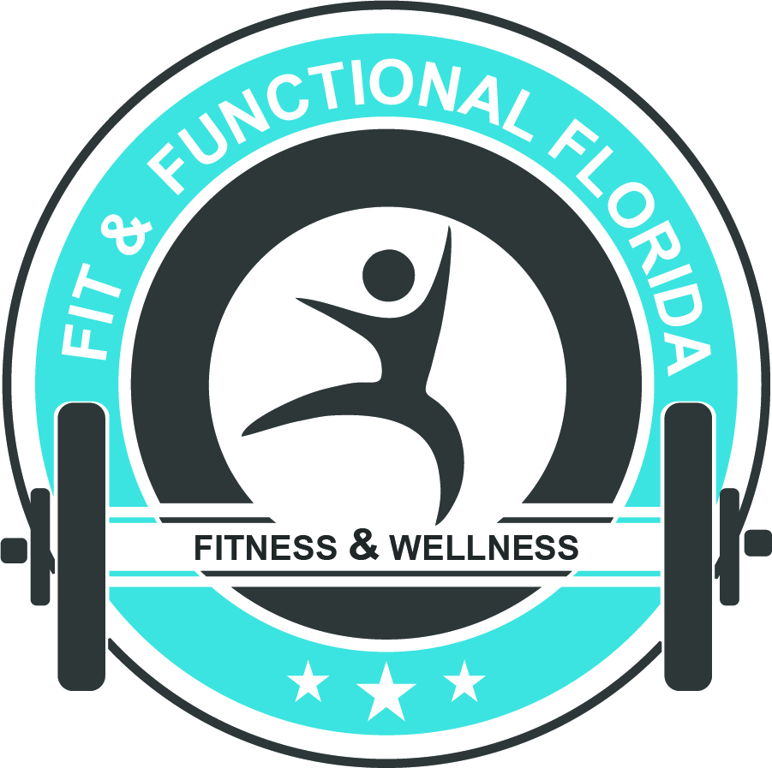
FUNCTIONAL FOUNDATIONS
Workbook

Slide 2
Functional training is an approach to exercise and athletic training that prescribes exercise as it relates to the movements the individual will experience in either daily life or sport.
As a trainer, functional training is important because it allows the trainer to establish goals for clients that are purposeful to their lives. Engaging in this approach allows the trainer to improve upon the ability to complete daily tasks, or sport-specific skills.

Slide 3
The term functional training is exactly what it infers: training that has a functional purpose for the individual being trained. It does not make sense to take a trainee and put them through a series of exercises simply to “keep them in shape”. Functional training is intended to work with movements, or exercises that are intended to help a trainee’s ability to achieve and complete daily activities and goals.
Goals are important because they allow the trainer to understand what exactly the trainee needs in their exercise program. Functional exercises for trainee will depend on their specific goals

Slide 4
Functional training is considered to be functional do to their movements or exercises that improve a person’s ability to complete their daily activities or to achieve a specific goal; therefore the training is function for that trainee and their set of goals.
Functional training is composed of a few basic tenets that are all incorporated into a training program. These tenets are intended to create a balanced program in multiple plains of motion to ensure that the nervous system and all limbs are functioning properly.
An appropriate functional program is comprised of core stability training, flexibility, and balance training.
Functional training is an approach that can be applied to everyone because the training will be based on the specific client.

Slide 5
The human body will always adapt to its function: meaning that our bodies will adapt to whatever the most repetitive circumstance it is subjected to. Repetitive activities will always be present in our daily lives, and these activities can eventually lead to pain since some muscles are worked more than others, thus creating imbalances. Being that the body is a natural system of levers, designed to function with balanced musculature, misalignment can put joints at a biomechanical disadvantage.
When the body becomes “worn out” due to structural imbalances, impingement of joint spaces, joint irregularities, arthritis, bulging disks, and sometimes tiny fractures in the spine occurs to the tissues of the body.
Pain, poor sleep, scar tissue build up, and muscle atrophy all result from postural distortions.

Slide 6
FAQ:
Should I do fast or slow repititions? The speed of the repetitions should be based on the speed of the required activity. The body needs to be trained at the same, or a higher velocity during exercise to benefit a particular activity. A sprinter doesn’t jog to increase their speed. Slow training is good for form training, rehabilitation and hypertrophy.
My friend works out at the local gym and mostly uses machines. He has been doing the same routine forever and has had good results. Is this program good for me? NO! If you stick to it, any exercise program will produce results whether it is done right or wrong. Unfortunately when exercise is done incorrectly, the harmful effects may not be noticed until the damage is done. By exercising functionally, you will systematically attain your goals and insure that your time in the gym is spent safely and efficiently. Just because someone looks good does not mean they are an expert.
Can functional training benefit anyone? Yes. Functional workouts are beneficial for any athletic level or age group. When you train in this fashion, you will see drastic improvement in overall health and performance not just appearance.
Shouldn’t I do cardio and lose weight before I start a functional program? NO! You should have a functional training program that concentrates on raising and lowering your heart rate. The program should first use body weight exercises, then advance to free weights. This promotes lean muscle mass, skeletal integrity, and healthy cardiac function. Muscle mass accelerates fat loss.

Slide 7
FAQ (cont.):
My friend tells me to do three to five sets of 10-12 repetitions to failure, with one minute rest intervals. This is what everyone who thinks of the gym envisions. This is not a good program unless you are a body builder. If you train in a functional fashion you burn more calories and get more benefit from your sessions outside of the gym.
Aren’t aerobic classes and the treadmill enough? NO! A weight training program that includes balance, core stability strength and cardiac conditioning builds lean muscle mass. When you build muscle, you burn more calories at rest and during your daily activities. Therefore, by adding resistance to your program, you will actually will burn more calories doing the same aerobic class or distance on the treadmill.
Should I stretch before or after exercise or an event? Evidence demonstrates that static stretching before an activity is not beneficial to prevent injury. If you want to avoid injury you need to be flexible by doing regular stretching – not just before activity. Active and dynamic stretches, with a short warm up mimicking the activity before, with PNF and static stretching at the end help remove waste from the muscles.
Why have none of my doctors told me to stretch and exercise to alleviate pain? Unfortunately we live in a society where some doctors prescribe medications for everything imaginable. Everyone wants immediate gratification (a pill) not a long term solution (exercise). The fact is most people ignore the doctors’ requests to stretch and exercise. Most minor health problems can be eliminated by moderate exercising but people choose to take medications because it is easier.

Slide 8
FAQ:
I injured my knee and my doctor told me to rest it for a while. Do I? So long as the joint is stable, this is the worst thing you can do. Pampering a stable injury for extended periods causes muscle atrophy and decreased blood flow. All injuries should be functionally rehabilitated under careful supervision by a health professional. There are doctors that base their whole practice on movement therapies for injuries, find them. Keep in mind there are injuries that rest is the only answer.
Should I cut carbohydrates out of my diet? NO! Only cut out high, glycemic carbohydrates. Carbohydrates are essential for cellular function. Eating carbohydrates that do not spike insulin levels is healthy and effective for weight loss.
My doctor told me to walk to get some exercise for my aches. Is walking enough? NO WAY! If walking were enough, everyone would be healthy as we all walk. If you have pain chances are there is a biomechanical issue. My first suggestion would be to stretch. More walking may further aggravate the issue; you need to correct the imbalance first, not just walk more. I suggest seeing a Physical Therapist for this situation if stretching doesn’t help.

Slide 9
As a trainer, it is very important to know the movements of the body since the purpose of training consists of the body moving correctly. Training is developing the musculature of the body through movement, and if a trainer does not understand these movements, they can cause injury.
All muscle groups are intended to support joints and allow for balanced movement of limbs, along with maintaining postural stability.

Slide 10
Flexion - bending of a joint that decreases the angle
Extension - straightening of a joint that increases the angle
Hypoextension - less extension than normal
Hyperextension - extension beyond normal limits
Abduction - away from the body
Adduction – towards the body
Pronation – palms facing down
Supination – palms facing up
Rotation – around the axis
Circumduction – circular movement
Protraction - forward motion, occurs at glenohumeral joint
Retraction - backward motion, occurs at the glenohumeral joint

Slide 11
Internal Rotation - while rotating on its own axis, the anterior surface moves toward the midline
External Rotation - while rotating on its own long axis, the anterior surface moves way from the midline
Elevation- moving or lifting a body part in a superior direction
Depression - moving a body part in an inferior direction
Dorsiflexion - movement at ankle; pointing foot up towards body
Plantarflexion – movement at ankle; pointing foot down
Inversion - turning feet inward so the soles face each other
Eversion – turning the soles outward
Gliding - movement of non-angular joints over each other
Deviation - departure from the midline

Slide 12
Muscles control every aspect of human movement. Without our muscles, bones would not be able to move to various positions that are needed for daily activities. The purpose of exercise is to keep our muscles and body in good working order. However, due to daily activities and life styles, muscles begin to function differently than when we are born. Some muscles work more than others, which can eventually lead to imbalances. Some limitations could be flexion/extension of the shoulder, or lack of Internal/external rotation of the hip. It is the trainer’s job to understand the muscles of the body and how they function so that imbalances presented by trainees can be corrected. Without knowing anatomy and how the body functions could be detrimental to the well being of the trainee.
A muscle’s origin is where the tissue begins and does not move during the muscle action while the insertion is where it ends and moves during the action.
During a muscular contraction, the contraction begins at the distal end of the muscle going to the proximal end. In relation to the muscle’s origin and insertion, the distal end is referred to as the insertion while the proximal end is the origin.
When a muscle or muscle group is considered to be hypertonic, that means that the muscles are overactive. This creates a disruption in normal sequencing and function, as that particular muscle or muscle group is not at its normal resting length and can negatively affect posture and performance.

Slide 13
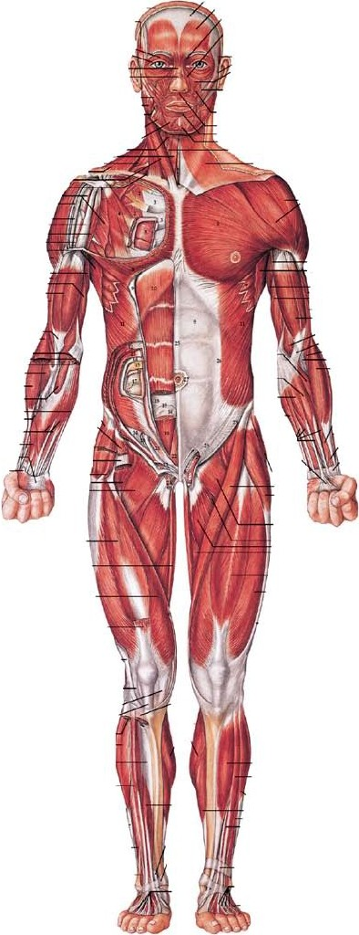
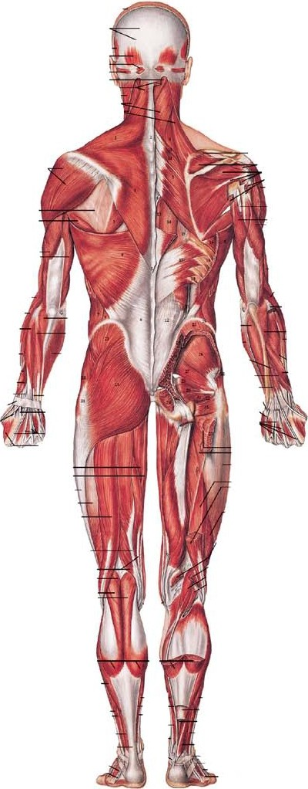
THE MUSCULAR SYSTEM
Anterior View Posterior View

Slide 14
The Muscular System
Hip - Hip extension/flexion
Hamstrings - Knee flexion; hip extension
Quadriceps - Knee extension; hip flexion
Calfs (anterior and posterior) - Plantarflexion; knee flexion
Shoulder (glenohumeral) - Extension, flexion, horizontal extension/flexion, adduction/abduction, in/external rotation, protraction/retraction, elevation/depression
Chest - Extension/flexion, horizontal extension/flexion, protraction/retraction
Arms - Flexion/extension
Abdominals - Extension/flexion, rotation, lateral flexion
Spinal Stabilizers - Lats, Glutes, Erectors, Rectus abdominus
Upper Back - Elevation/upward rotation
These muscles are considered the Prime Movers of biomechanical movement, yet comprise only a fraction of the total number of muscles in the body. The rest of the muscles are either for acute functions, such as eye movement, or synergistic function. Synergist muscles act to stabilize and assist prime movements in their muscular movements.

Slide 15
The Skeletal System
The skeleton provides the framework and support needed to perform the various movements that occur during exercise or sport.
The functions of the human skeleton include: protecting our vital organs such as the brain, heart and, lungs; providing a moveable rigid structure; Red blood cells are manufactured in long bones; providing attachments for muscles as a leverage system.

Slide 16
Long bones are found in the extremities and consist of a body (or diaphysis), the cavity in the middle of the bone (or medullary cavity), and the ends (the ephiphyses). Long bones include clavicle, humerus, radius, ulna, femur, and
tibia. Long bones act as levers within the musculoskeletal system.
Cancellous bone has very porous areas that allow for the blood to pass through. Cancellous bone functions to form bone marrow.
Short bones are found in parts of the skeleton that is intended for strength and compactness. These bones consist of cancellous tissue covered by a thin layer of compact substance supported by the periosteum. Short bones include the patellae and seamed bones.
Flat bones are typically used for extensive protection or broad surfaces for muscular attachment. They are formed by two thin layers of compact bones with cancellous
bone between them. Flat bones include sternum, ribs, and the hip bones.
Irregular bones consist of cancellous tissue enclosed within a thin layer of compact bone. Irregular bones include vertebrae, sacrum, maxilla, and
mandible.

Slide 17
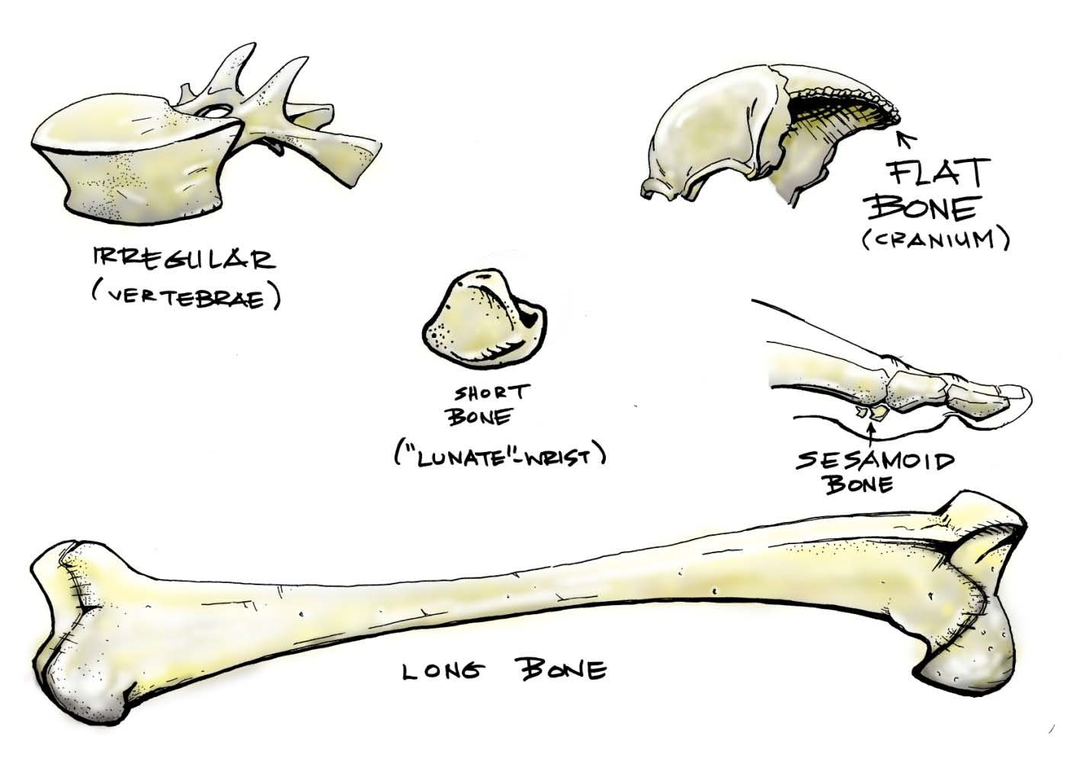

Slide 18
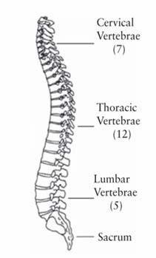
The spinal column serves to act as a support structure to maintain the torso during movement, it allows energy transfer during movement, provides stability, and is a major pathway for the central nervous system.
The movements of the spine include extension, flexion, rotation, and lateral flexion.

Slide 19
Kyphotic – The natural curvature of the thoracic vertebral column
Lordotic – The natural curvature of the cervical and lumbar vertebrae
Swayback – excessive lordotic curvature of the lumbar or cervical vertebrae
Spinal Extension – bending of the spine posteriorly
Spinal Flexion – bending forward at the waist

Slide 20
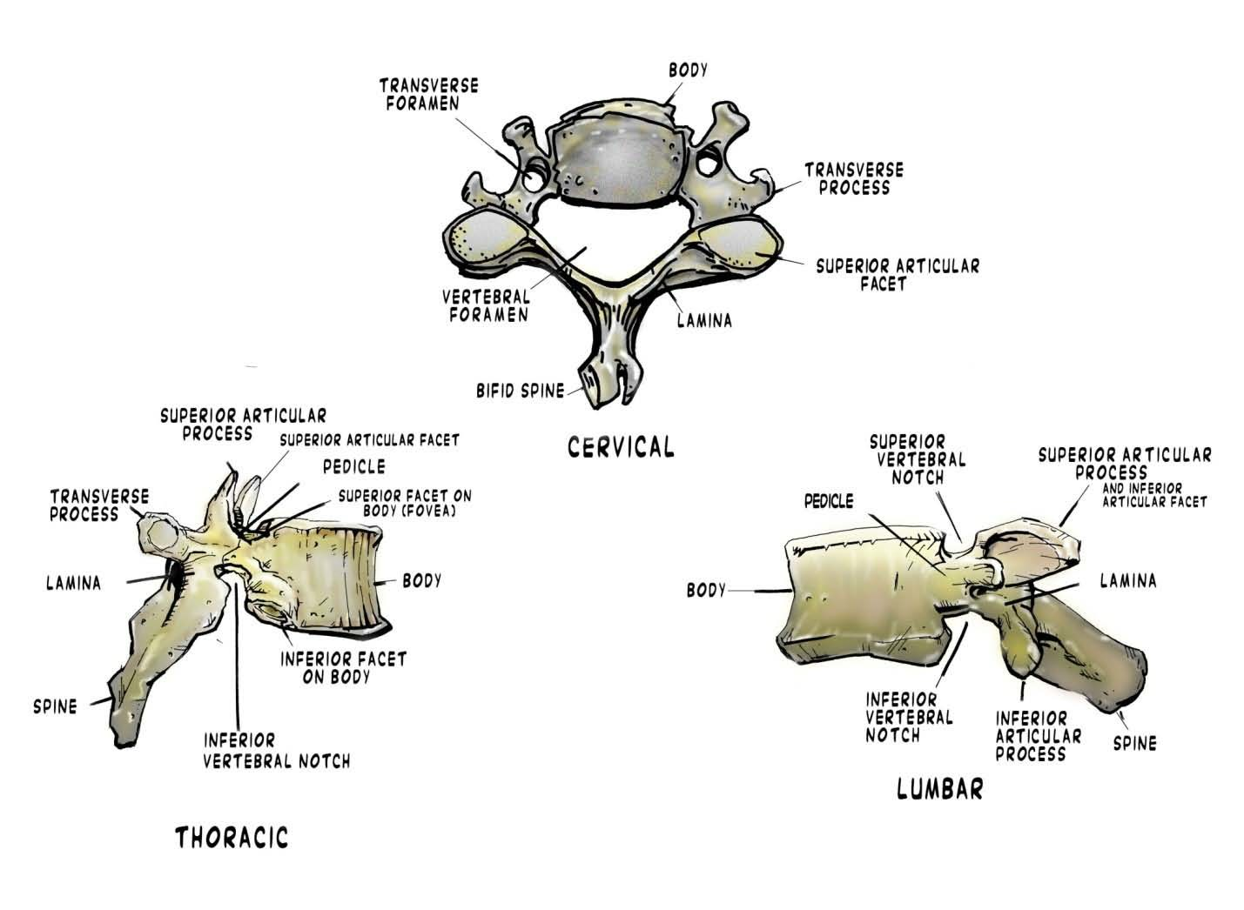

Slide 21
As a trainer, it is important to know what the different parts of the vertebrae are and what purpose they serve because muscle attachment points to different parts of individual vertebrae and that will determine what type of movement the muscle produces.
Positions and movements of the spine relate to a person’s movement in that shape determines position. Weak muscles, or muscular imbalances lead to incorrect spinal curvature, which can lead to overcompensation either through excessive extension or flexion. Poor posture is usually the result of incorrect movement, and leads to faulty movement patterns at the joints and spine itself.

Slide 22
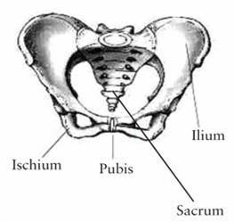

Slide 23
Two important functions of the pelvis are:
• Act as a base of support
• Transfer force and allow for lower extremity function
the muscle groups that originate from the pelvis:

Slide 24
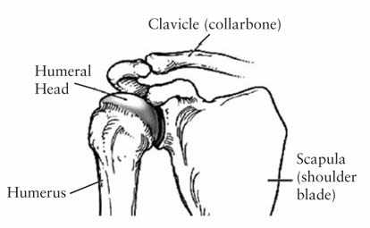
The muscle groups of the shoulder are the deltoids, rotator cuff muscles, pectorals, trapezius, rhomboids, and latissimus dorsi.

Slide 25
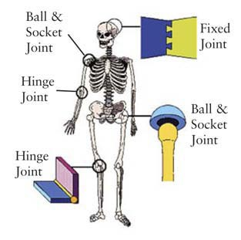

Slide 26
The material found on the end of each bone is called cartilage. It serves to protect joints.
A bursa is a fat pad and serves to cushion the joints.
Of the different types of joints in the body, they are classified as either synarthroses, or diarthroses, which means they are immovable or movable.

Slide 27
Tendons - Connects skeletal muscle to bone. Type of dense connective tissue that contains collagen fibers in parallel bundles. Contains great tenstile strength to sustain great forces exerted by the muscle belly
Ligaments - Tissue comprised of collagen used to link bone to bone; Connects bone to bone. Made of dense connective tissue but more elastic fibers than tendons; must be able to stretch more. Three types: 1) reinforcing 2) guiding 3) restrictive

Slide 28
Without understanding and resigning degrees of joint motion, as a trainer, it would be difficult to assess and determine whether a person has limited or excessive ranges of motion and why.
Degrees of motion lesser or greater than required indicate muscular imbalances, or extreme flexibility
Limited ranges of motion indicate that a muscle may be over-worked, and the compensation has resulted in a shortening of the muscle. The muscle needs to be stretched and elongated, as well as the surrounding musculature needs to be strengthened as it is most likely weak. Excessive range of motion is not necessarily harmful; however it needs be considered whether or not that range is beneficial. Strengthening that particular muscle or group could prevent injury.

Slide 29
Lumbar Spine
Flexion: 75 degrees
Extension: 30 degrees
Lateral bending/flexion: 35 degrees
Shoulder
Abduction: 180 degrees
Adduction: 45 degrees
Horizontal extension: 45 degrees
Horizontal flexion: 130 degrees
Vertical extension: 60 degrees
Vertical flexion: 180 degrees
Elbow
Flexion: 150 degrees
Extension: 180 degrees
Supination: 90 degrees
Pronation: 90 degrees
Wrist
Flexion: 80-90 degrees
Extension: 70 degrees
Radial deviation: 20 degrees
Ulnar deviation: 30-50 degrees

Slide 30
Hip
Flexion: 80-90 degrees
Extension: 70 degrees
Radial deviation: 20 degrees
Ulnar deviation: 30-50 degrees
Knee:
Flexion: 110-130 degrees
Extension: 30 degrees
Abduction 45-50 degrees
Adduction: 20-30 degrees
Internal Rotation: 40 degrees
External rotation: 45 degrees
Flexion: 130 degrees
Extension: 15 degrees
Internal rotation: 10 degrees
Ankle:
Dorsiflexion: 45 degrees
Plantarflexion: 20 degrees
Pronation/Inversion: 30 degrees
Supination/Eversion: 20 degree

Slide 31
The nervous system is the central command center that allows us to gather information about our internal and external environments, process and interpret it, and then respond.
The CNS is vital to our everyday lives. Without, we cannot perform daily functions and tasks that we often take for granted. Breathing, walking, eating, aside training and complex movements are all products of a functional CNS. Without the nervous system, our bodies cannot function as intended.
The CNS is composed of the brain, brainstem, and spinal cord
It’s important to understand the parts of the brain and their function as the brain and its function dictates our existence. All functions of the human body are governed by the processes of the brain, without which, we would not be able to function. Understanding brain function is relative to trainers, as all training is the result of the impulses conducted by the brain as interpreted by the signaling of the nervous systems.

Slide 32
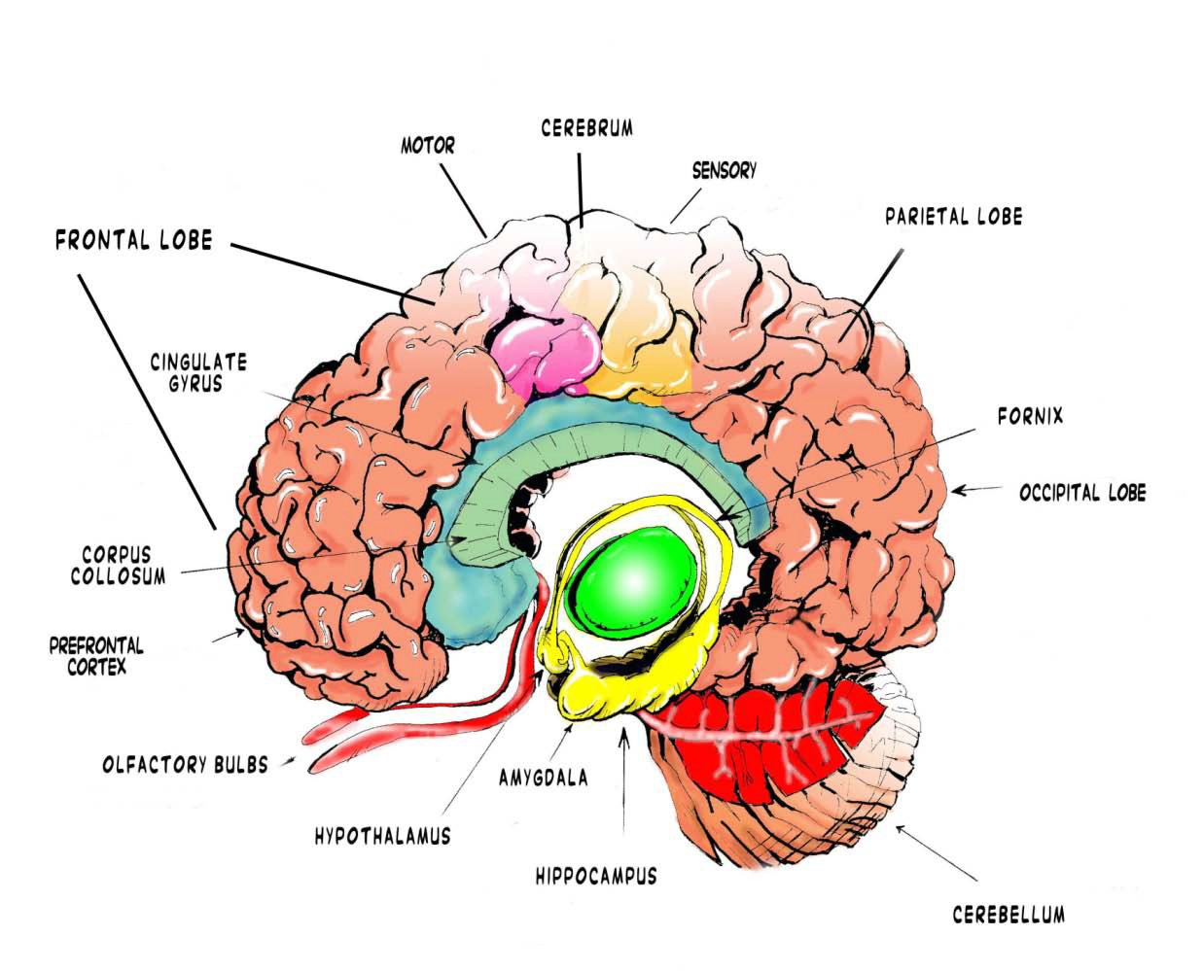

Slide 33
Occipital Lobes
-Visual and spatial processing
-Smallest of 4 lobes
Cerebellum
-Based upon necessary input it receives, the cerebellum decides the best way to intiate and execute movement
-Vital for all multi-sensory exercises
Cerebrum
-Control center of the brain; it controls your voluntary muscles
-Consists of 4 lobes, 2 hemispheres, and makes up 85% of the brain’s weight
Cerebral Cortex
-Maintains control of movement in the body
-Located on the outer portion of the brain
Frontal Lobes
-Involved in motor function and has control over our emotional responses and personality
-Located at the front of the cranium

Slide 34
Parietal Lobes
-Interpreting where your body is in space and time
-Located above the Occipital lobe and behind the Frontal lobe
Occipital Lobe
-Interprets what you’re looking at
-Located in rear of skull
Temporal Lobes
-They enclose the two hemispheres of the cerebellum, Hippocampi and the amygdalae
Hippocampus
-Plays major role in memory and spatial navigation
-For example when someone gets Alzheimer’s the Hippocampus is one of the first brain regions affected.

Slide 35
Limbic System
-Dictates mood and emotion in the body
-For example when your upset and use food as an anti depressant that is your
Limbic system causing that
Olfactory Bulb
-Identifies odors
-Odor information has strong connection to emotional memory
Thalamus and Hypothalamus
-Functions include controlling appetite, sleep patterns, sexual drive, and response anxiety
Anterior Cingulate Cortex (ACC)
-Regulates heart rate and blood pressure, and plays a vital part in decision- making, anticipation, empathy
and emotion
-Located Frontal part of Cortex

Slide 36
Three important features of the spinal cord are:
-Transmit motor signals from the brain
-Transmit sensory signals to the brain
-Center for coordinating certain reflexes
The spinal cord is divided into 31 different segments beginning from the medulla oblongata and continuing to the conus medullaris near the lumbar L1-2. The spinal cord transmits sensory information from the PNS to the brain using afferent pathways. Branching off of the spinal cord are various sensory nerve roots that assist with movement.
Cervical – 8 neck
Thoracic – 12 upper back
Lumbar – 5 lower back
Sacral – 5 pelvic area
Coccygeal – 1 tailbone area

Slide 37
The PNS functions as an auxiliary connection from the CNS to activate the muscles and organs of the body. The PNS, through the spinal cord, relays information or stimuli that is occurring at all points of the body outside of the spinal cord to tell the brain what is occurring at the extremities, and thereafter release impulses to initiate response or movement.
Daily activities and sporting movements are all products of brain function. The CNS is the main governing mechanism responsible for regulation and how our bodies move. The PNS is a component of the CNS, and is responsible for voluntary functions. The PNS activates bodily organs and muscles. The PNS also relays information from the body’s organs back to the brain.

Slide 38
Afferent – afferent pathways conduct sensor information from the PNS to the brain
Efferent – efferent pathways send information from the brain through the spinal cord to specific areas of the body that need to be effected
Autonomic Function – functions that affect all of the other tissues and organs that are not skeletal muscles in the body
The peripheral nerves of the efferent division are divided into the somatic and autonomic nervous systems. The somatic nervous system connects skeletal muscles to the body to allow for movement, while the autonomic nervous system controls non-skeletal muscles, which are involuntary parts of the body such as organs, hormone production, digestion.

Slide 39
Many different activities occur internal so that our bodies can prepare and perform exercise and sport. The somatic nervous system influences the skeletal muscles of the body and provides the means for the nervous system to initiate and produce movement while the autonomic nervous system affects systems that allow people to involuntarily adapt to the environment.
Homeostasis of the ANS is achieved through the balancing of SNS and PNS nervous systems.

Slide 40
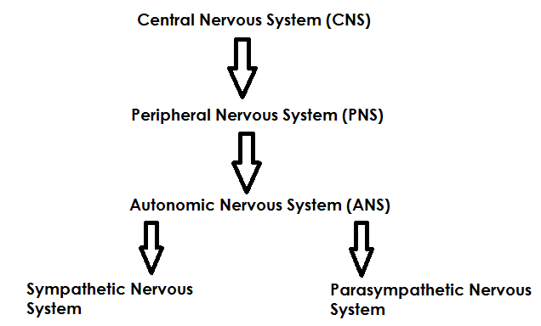

Slide 41
The SNS and PNS are highly involved in transitioning the body for exercise and relaxation. Training allows us to go back and forth between the SNS and PNS more efficiently to perform and recover quicker. When we are excited the SNS is activated, when calm and relaxing the PNS is activated. Autonomic Regulation is responsible for these transitions.
An easy way to remember is the SNS is the fight or flight and the PNS is the wine and dine pathways. Based upon the information in the text, list and describe how the SNS prepares the body for an upcoming stressor (exercise), and relaxes after a stressful situation.

Slide 42
Nociceptors - Respond to pain such as pain receptors
Chemoreceptor - Respond to chemical interactions such as smell and taste
Photoreceptors – Respond to light such as vision
Mechanoreceptors – respond to mechanical forces such as touch & pressure; located in muscles, tendons, ligaments, and joint capsules. Include muscle spindles, golgi tendon organs, and joint receptors.
Muscle Spindles – major sensory organs of the muscle that are sensitive to change in length and rate of length of change. When a muscle is stretched, its spindles are also stretched and excited. The excited muscle spindle will cause the muscle to contract, preventing the muscle from stretching too far/too fast to prevent injury.

Slide 43
Golgi tendon organs - Located within musculotendinous junction and are sensitive to changes in muscular tension and the rate of tension change. When excited, the GTO will cause the muscle to relax; preventing it from being placed under excessive stress and/or injury. Prolonged GTO stimulation provides an inhibitory action to muscle spindles; a phenomenon called autogenic inhibition
Joint receptors – located in and around the joint capsule, they respond to pressure, acceleration, and deceleration of the joint. Signal extreme joint positions and thus help prevent injury.

Slide 44
Muscle spindles are very important for athletes. When the muscle is stretched, the spindle will cause it to contract rapidly as a protective measure. However, the reflexive response that occurs is beneficial. Through a mechanism recognized as the Stretch/Shortening Cycle, movements such as a countermovement jump, sprint cycle, or an Olympic lifter “rebounding” out of the bottom of a deep snatch or clean, are all reflexive responses of the muscle spindle that allow for greater force and tension to be created which subsequently allow for enhanced performance.
Together these three mechanoreceptors help protect the muscles and joints from injury due to excessive movements and/or pressures

Slide 45
A neuron connects the brain and muscle, transmitting an impulse from brain to the muscle, to innervate the muscle. Consider it to be the extension cord that comes from a power outlet in the wall, and goes to a radio or phone charger. A neuron acts the exact same way in our bodies so that we are able to function.
A damaged neuron loses its ability to function properly. Neurons cannot replicate like other cells in the body but some neurons can regenerate or repair specific parts if the cell body remains
intact.

Slide 46
Sensory/afferent - transmit afferent nerve impulses from receptors to the brain and/or spinal cord
Motor/efferent - transmit efferent nerve impulses from the brain and/or spinal cord to effector sites such as muscles or glands
Interneurons- transmit nerve impulses from one neuron to another

Slide 47
Axon – cylindrical projection from the cell body that transmits nervous impulses to other neurons or effector sites
Axon Terminals – specialized hair-like structure at the end of the axon that is used to release neurotransmitter chemicals and communicate with target neurons allowing conductivity into the area
Cell Body – contains the nucleus (also called the soma) and other organelles such as lysosomes, mitochondria, golgi complex
Dendrites – branching structure of a neuron that receives messages; responsible for gathering information from other structures back into the neuron

Slide 48
Myelin Sheath - the fatty substance that surrounds and protects some axons; also provides for higher conduction velocity
Node of Ranvier – one of the many gaps in the myelin sheath; where the action potential occurs
Nucleus – the organelle in the cell body of the neuron that contains the genetic material of the cell
Schwann Cell – variety of neuroglia that mainly provides myelin insulation to axons in the PNS
Gap Junction – where the synapse jumps from Schwann cell to Schwann cell over the gap junction by conduction of the myelin sheath

Slide 49
Acetylcholine (ACH) – neurotransmitter extensively found in the brain and autonomic nervous system; stimulates the muscle fibers to go through a series of steps that produce muscle contractions
Ganglion – cluster of cell bodies, such as the dorsal root ganglion of peripheral sensory nerves and sympathetic chain ganglion

Slide 50
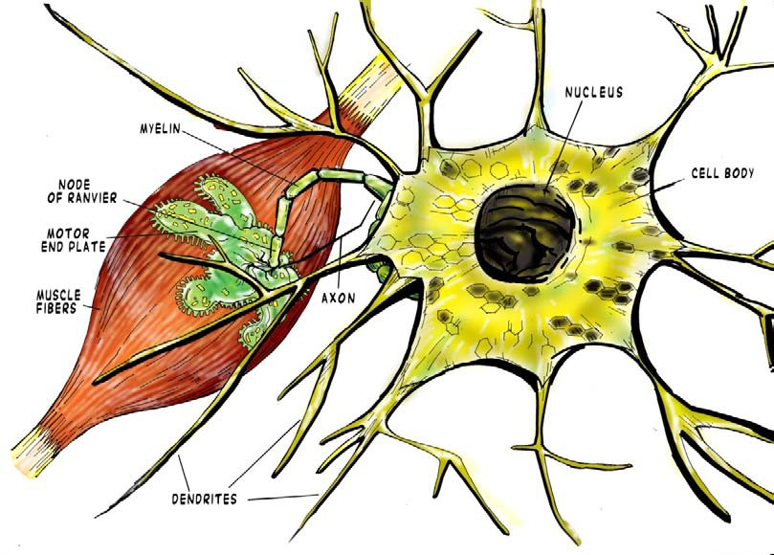

Slide 51
The action potential is initiated in the brain and sent down the axon of one neuron to be received at the dendrites of the next neuron. The impulse continues down the efferent pathway until it reaches its target muscle. Here, the neuron releases acetylcholine into the neuromuscular synapse. AcH diffuses across the synapse and binds to AcH receptors on the muscle which initiates a muscular contraction.

Slide 52
It’s important to understand the planes and degrees that the body moves because it allows us as trainers to recognize a clients ability to move in the way it was intended.
The laws of physics dictate movement patterns in everyday life, whether or not one is training.

Slide 53
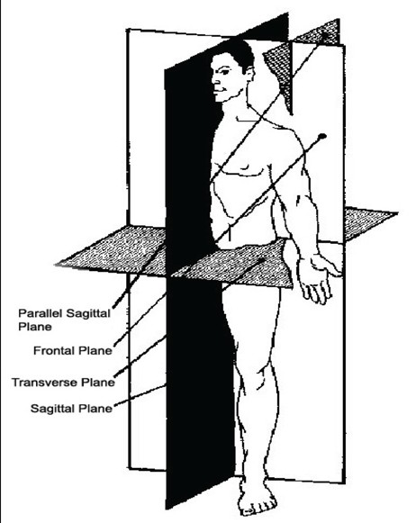

Slide 54
Parallel Sagittal Plane – parallel with midline, divides the body laterally
Sagittal Plane – alongside the body (ie: elbow bending forward, squat)
Transverse Plane (Horizontal Plane) – divides the body superiorly and inferiorly (ie: rotation at the waist, bench press, internal/external rotation
Frontal (Coronal) Plane – divides the body into front & back (ie: lateral raise, pulldown, military press)

Slide 55
Cranium – fixed joints, very limited movement
Neck – flexion/extension; lateral flexion; rotation
Acromioclavicular – elevation/depression
Glenohumural – extension; abduction/adduction; internal/external rotation
Scapula – protraction/retraction
Elbow – flexion/extension; pronation/supination
Wrist – flexion/extension; radial/ulnar deviation

Slide 56
Fingers – flexion/extension; abduction/adduction
Hip – flexion/extension; abduction/adduction; internal/external rotation
Knee – flexion/extension
Ankle – plantarflexion/dorsiflexion; inversion/eversion
Toes – flexion/extension

Slide 57
Movement occurs within the human locomotor system through strength, force, and power created by the musculoskeletal system. The contractile tissue, non-contractile tissue, joints, and skeleton are used to create levers to maximize and produce strength, force, and power that are more efficient for motion or work. The skeletal system provides the framework and support needed to perform the various movements occurring during exercise or sport. Contractile tissue moves the bones and creates the necessary force and power of the athlete. All of the levers in the
body are designed to assist in movements. Some of these levers are more apt to produce force than others, which is why, as a trainer, it is necessary to understand the physical demands placed on the body so that it can be used properly when implementing training programs.

Slide 58
Newton’s First Law of Motion is the law of Inertia
Two types of inertia are static & dynamic.
Static – the mass you are working against doesn’t want to move; ie: lifting a weight
Dynamic – an object wants to stay in motion unless acted upon by another force. This can be motive or resistive
Motive Force – assists when moving an object (momentum)
Resistive Force – forces working against motion
Constraint – a limiting factor

Slide 59
Two types of constraints:
Environmental – spatial, temporal
Biomechanical – leverage, friction, gravity, morphology, time lags (impulse transmission), zooms
Newton’s Second Law of Motion states that the direction of the force vector is in the same direction of the mass’ acceleration vector.
F=ma is the relationship between an object’s mass, its acceleration, and the applied force. This formula relates to weight training in that the objects moved are relative to the mass and acceleration. Specifically when training athletes, it is important to know how this formula presents itself physically, namely in the function of exercises that require force development. The amount of force an athlete can produce is determined by speed of the movement.

Slide 60
Newton’s Third Law of Motion states that for every action there is an equal and opposite reaction. For each bit of force produced to move a weight, there is an equal and opposing resistive force that the weight applies to the individual. The same is true during eccentric, isometric, and isotonic contractions. The law holds particularly true to explosive movements such as plyometrics and Olympic lifting, as the amount of force exerted must overcome an equal force to create the explosive movement.

Slide 61
Center of gravity is considered the balance point, or the specific area on which the surrounding forces are equal to zero. The center of gravity changes through all motions seen in the human body, although, the hip generally being considered as the center point of the body with which all points further from the center affect the point of balance. The closer the center of gravity is to your base of support, the more stability. Posture attempts to balance the forces in the body so their sum equals zero.

Slide 62
Base of Support is where your body comes into contact with the supporting surface. You can increase a trainee’s ability to keep their center of gravity over their base of support.
Balance – the act of keeping your center of gravity; your base of support
Stability – the ability to keep the center of gravity over the base of support. The closer the center of gravity is to the base of support, the more stability one will have
Equilibrium – this is the act of keeping your center of gravity; your base of support and restraining from moving beyond your center of support

Slide 63
Force is a magnitude that can go in any direction. Force either produces or prevents motion, and a visible change in motion need not occur when a force is applied. This means that a force can be applied to an immovable object. Understanding how force works is important to understanding how the body produces force. When muscles contract, the point of application is found at the attachment of the muscles, and the direction of the muscular force usually runs from the insertion of a muscle toward its origin. In terms of center of gravity, a reaction force acts on the center of gravity. An example would be cable crossovers; leaning forward to stabilize to prevent being pulled back- this is how the body would compensate when force is being produced that disrupts the center of gravity.

Slide 64
A vector quantity is a force that has and
. When two vectors are connected, you have what is called a
, which can be considered to be the hypotenuse side of a
triangle. Consider a bicep curl: the point of application would be considered where the muscle inserts on the body, the origin of the muscle is the direction that the force will be
traveling towards, and the contraction constitutes the force being applied to create a vector quantity. Based upon the motion of the vectors, there are various
, or changes in position that can occur. What are some of the forms that they can take?
Different forms of displacement include: straight line, curving line, flying
point of application, magnitude, direction, resultant, displacements

Slide 65
The body’s basic ability to produce maximal force is called absolute muscle strength. Everyone is limited to the amount of force that they can produce. Athletic programs must consist of large amounts of work developing strength, as well as power, if the athlete is to be successful. Power, which is governed by absolute strength, is the amount of work done over time, hence the equation of P=W/T.
Consider a deadlift and a power clean: one exercise consists of bringing a barbell from the floor to hip-height; the other consists of bringing a barbell from the floor to shoulder-height. The power clean is more powerful in that greater force is needed to move the barbell a greater distance.

Slide 66
Velocity is defined as V=D/T. D, stands for displacement and T, stands for time. Velocity is the amount of displacement(meters/feet/yards) occurring over a specified time period(seconds, minutes, hours).
Translating motion is when angular motion combines to create a linear
motion. An example of this would be the bench press, in which there is angular motion around the shoulder joint (glenohumeral) joint, but linear motion of the held weights.
The equation and definition of work(W) is W=F*D; where F equals force and D equals distance. Work is the accumulated product of the force created and exerted on an object and the distance the object is displaced in the direction it has been moved

Slide 67
A machine is any devise which transfers force from one point to another. According to the Principle of Conservation of Energy, machines can either increase in force with a concomitant decrease in motion, or increase motion with a increase in force.
The two basic types of machines are levers and inclined planes. In relation to human movement and training, the human body is a system of levers that transfer force from one point to another, as they are designed to act against external forces placed on the body.
Something is said to be at a mechanical advantage when the muscular effort applied is greater than the resistance(work needed to be done) so motion
occurs

Slide 68
The first class lever is when the effort and resistance are on the opposite side of the fulcrum. The second class lever is where the effort and resistance act on the same side of the fulcrum, whereas the third class lever is where the effort and resistance act on the same side of the fulcrum, but the moment arm of force is smaller than the resistance moment arm.

Slide 69
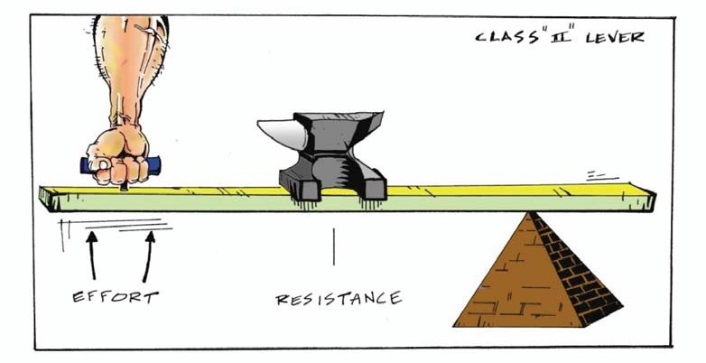
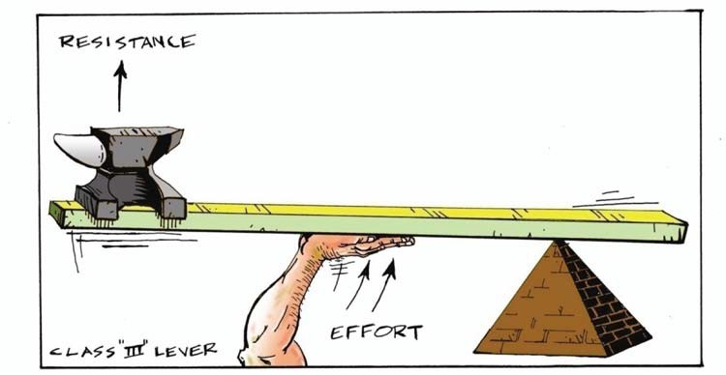

Slide 70
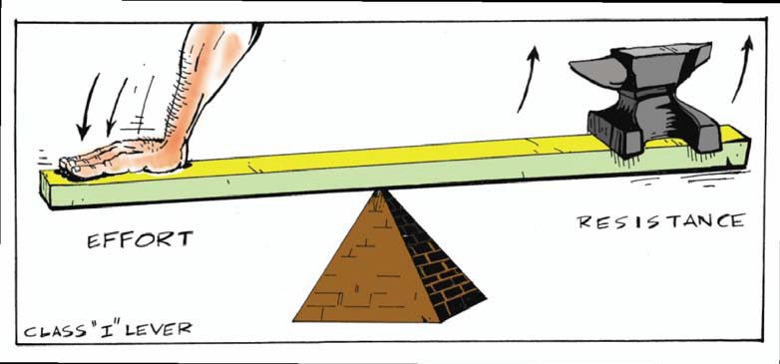

Slide 71
Class 1- Triceps brachii performing triceps push-down
Class 2 – Gastroc-soleus complex
Class 3 – Biceps Brachii
Levers from difficult to easy:
Class 2
Class 1
Class 3

Slide 72
Much can be assessed about an individual merely by observing their gait patterns. All of the body’s muscles should be working synergistically to produce an even and cadenced stride, and without any abnormalities in leg function. The gait cycle is comprised of two phases, which are the swing phase and stance phase.

Slide 73
Motor learning is the coordinated effort the CNS and musculoskeletal system to perform actions.
The brain is the main determinate in the development of movement patterns, skill development, and muscle condition.
Motor Learning – the process by which someone learns to develop skillful movement
Somatotopic – has a stimulating effect on body growth
Homunculus - Area I of the Somatic Sensory area contains regions that correlate directly with specific body parts and receive sensory input from these areas

Slide 74
The Cerebral Cortex is the part of the brain where learning occurs. This cortex is comprise of two regions know as the sensory and motor regions. The cortex responsible for movement is further categorized into three areas.
The three areas of the motor cortex are:
1) Primary motor cortex- contains representations of every muscle group in the body
2) Premotor area- controls the movement patterns of muscle groups to perform specific tasks
3) Supplemental motor area- seems to control “head and eye movements, attitudinal movements, vocalization, and yawning”, but little else is known
Within the Primary Motor Cortex, representations of every muscle group within the body. This allows for constant monitoring by the brain of the body’s state.

Slide 75
The premotor area will be responsible for carrying out actions involved in sports and training.
The somatosensory cortex is located posterior to the central sulcus and the motor cortex.
This cortex is divided into Somatic Sensory Area I and Somatic Sensory Area II. Somatic Sensory Area I is more dominant to sensory function.
The hands, feet, and lips have more sensory receptors than most. These body parts need to be more sensitive and therefore have more receptors in order to perform their functions properly.

Slide 76
When athletes train to become more adept at their sport via various sport-specific drills, they are training their brain to become more efficient at movements related to the demands of the sport. The premotor area is responsible for this type of development.
The cerebellum assists in coordinating movement patterns of the distal extremities and also in coordinating the timing and sequence of movements.
Within the Cerebellum there are two hemispheres with a middle region that is referred to as the vermis. This is comprised of three functional divisions, the
spinocerebellum, cerebrocerebellum, and vestibulocerebellum, that receive
Input signals, and sends output signals to various parts of the CNS.

Slide 77
Spinocerebellum – processes information regarding limb and joint position
Cerebrocerebellum – involved in motor control such as fine finger movements in typing
Vestibulocerebellum – involved in balance and eye movement function
All three divisions are responsible for a different type of motion necessary to make athletic movements and training safely.
Dorsal columns are the areas of the spinal cord that carry proprioceptive input to the brain.

Slide 78
Proprioception is the sensation of knowing a body part’s position in space. This system does not rely on visual cues to determine body’s position rather it is solely based on the feedback of the mechanoreceptors.
Muscle spindles and Golgi Tendon Organs are similar in nature. However, each has a specific function based upon the stressors exerted on the muscle. Muscle spindles - proprioceptive receptors that provide feedback on muscles when they are stretched or relaxed. This information is used to interpret position and movement of a joint based on the amount of stretch in a muscle.
Golgi tendon Organs - receptors that provide feedback on the amount of
tension being exerted on a tendon. It will cause the muscle to contract to avoid being over stretched

Slide 79
Proprioception, or the body’s ability to know its position is a result of the various sensory mechanisms, mechanoreceptors, GTO and muscle spindles. All of the following are located in the fascia of the muscle.
The Corticospinal Tract is a major pathway where nerves link muscles to the brain. Along this pathway, signals are transmitted from the efferent and afferent pathways to allow for movement.
Efferent pathways begin in the CNS at the brain and end at the effector sites somewhere within the body. Afferent pathways begin at a sensory receptor and end in the CNS at the brain.

Slide 80
An individual’s cognitive process allows them to learn the necessary movements performed during training. The various sensory mechanisms all affect upon the processing of motor tasks due to the nature of the task itself and how the musculature of the body responds. All motor tasks are affected by the ability of the sensory and motor pathways to interpret and transmit signal, as well as how well certain muscle groups function in relation to physical imbalances.

Slide 81
Cognitive/conscious awareness (learning what to do)- stage where one learns how to actually produce motion in a particular region of the body correctly that requires conscious effort and concentration.
Associative phase (develop plan of action)- stage where more complex and challenging movements will be added once one is comfortable moving in their functional range with kinesthetic awareness. This might include the requirement of muscle activation in order to stabilize the region to perform the motion.
Automotive phase (automatic)- occurs when the motion is embedded and does not have to be constantly thought of in order to perform. This will be demonstrated when motions can be performed on unstable surfaces or when there are several external challenges trying to alter the movement pattern.

Slide 82
When training an individual, taking into consideration their abilities is very important. Some individuals are more adaptive than others, but, nonetheless, progressions must be followed. It is never wise to attempt heavy weights, or complex movements with someone you are unsure of. Start simple, and work towards a higher degree of movement.
Proper Sequence of Progressions:
Unloaded to loaded Simple to complex Slow to fast
Endurance to strength to power
Increased resistance
Stable to labile (decreased points of support or use of unstable surfaces like ball or board)
It is important to follow a progressive order from less to more difficult so that the trainee can focus on the basic movement before being challenged by other variables.

Slide 83
As a trainee’s brain develops more consistent motor patterns, they will be capable of handling more complex movements and tasks.
Progression of the squat:
TRX or Foam Roller Squats
Unsupported squats
Weighted Squats
Squats on unstable surface
Reflex – automatic involuntary motor response to afferent signal
Reactive – action based on a cue or set order
Contextual Interference – being able to do any task at any time
Proactive – anticipating and carrying out what needs to be done in an array of environmental changes

Slide 84
When coaching beginners, the old adage of “less is more” holds much weight. A trainer can never expect a trainee to progress with leaps and bounds within a single session, nor should the trainer coach that way. A knowledgeable trainer should be able to recognize a variety of factors that are pertinent to the needs of the trainee.
Problems often associated with beginners and the role of a trainer in overcoming those problems:
Do not know where to focus
Takes too long to process information
Poor decision making
Poor movement patterns
Trainer’s Function in overcoming problems: Identify the goal
Identify the environment
Structure specific program according to goals
Provide motivation and maintain focus
Provide feedback

Slide 85
ATP is used in conjunction with a calcium ion to cause movement of the sliding filaments, actin and myosin, along the cross bridges. The resulting contraction is a result of the actin and myosin pulling together.
The components of a muscle cell are ribosomes, mitochondria, actin, myosin, myofibrils, sarcomere, sarcolemma, sarcoplasmic reticulum, motor end plate, perimysium, epimysium, endomysium.
3 types of fibers:
Skeletal muscle fibers
Smooth muscle fibers
Cardiac muscle fibers

Slide 86
White, fast-twitch: limited capillaries and mitochondria. Function limited in duration to high intensity, powerful bursts. Activities include, jumping, throwing, Olympic lifting, 1-3 repetition maxes.
Red, fast-twitch: moderate number of capillaries and mitochondria. Function limited in duration to short-duration bursts lasting no more than 30 seconds. Activities include, wrestling, sprinting, 6-8 repetitions.
Red, slow-twitch: increased number of capillaries and mitochondria. Functions limited to long-term postural maintenance, distance running, aerobic exercise, 15 + repetitions.

Slide 87
Even though there are three muscle fiber types, they are all the same in structure and form. What makes them different is the number of internal components such as myofibrils and mitochondria. The efficacy of each fiber-type’s performance is based upon the thickness and degree of insulation, or myelination of the nerve. Each different fiber type serves a select purpose based upon the need of the movement. Some individuals have a greater number of specific fiber types than do others, which is based solely upon genetics. The dispersion of these fiber types is also dependent upon the muscle in the body. Muscles used for posture will have more slow twitch fibers, while movement oriented muscles will have more fast twitch.

Slide 88
Myofibrils are comprised of the contractile proteins actin and myosin.
Myofibrils are the contractile components that allow for strength and the performance of work. They are comprised of the contractile proteins actin and myosin.
Sliding filament theory is the process where actin and myosin slide over each other to create a muscular contraction.
The mitochrondria, known as the “powerhouse” of the cell, are located all along the myofibrils. Mitochondria provide the energy a cell needs to move, divide, secrete, and contract. The energy thy produce is referred to as ATP which is used during contractions for daily activity and recovery energy needs.

Slide 89
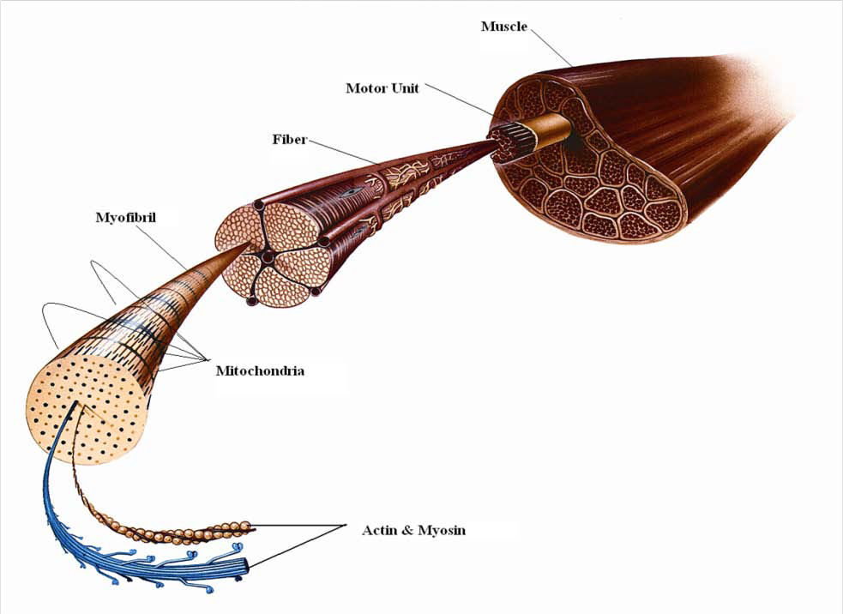

Slide 90
Regular, intense bouts of high repetition resistance training will lead to high functioning of the mitochondria.
Cell nuclei contains DNA, which is used for control of cellular functions. Without the hormonal functions of the pituitary, adrenal, and thyroid, DNA could not maintain muscle tissues. The absence of this hormonal stimulation would result in inactivity and degeneration of the muscle, also known as atrophy.
Ribosomes are the protein manufacturers of the muscle cell. They are located within the rough sarcoplasmic reticulum, which is part of the muscle cell. They are the assembly line that actually builds and repairs the contractile proteins actin and myosin.

Slide 91
Fascicles make up entire strands of muscle tissue. Each fascicle is comprised of fasiculi, which contain bundles of muscle fibers, or contractile components of a muscle. It is here where there are tens of thousands of myofibrils that hold millions of bands where the contraction occurs identified as the sarcomere.
Sarcomere – myofibrils are composed of up to millions of bands laid end-to-end referred to as sarcomeres.
Most skeletal muscles are either fusiform or pennate fibers.

Slide 92
Fusiform - A muscle that has the shape of a spindle, which is wider in the middle and narrows at both ends; this allows for greater range of motion but limited strength
Quadrate – A muscle that is square shaped, with parallel fibers that run directly from origin to insertion
Triangular – A wide origin that converges to a narrow insertion resembling a triangular shape
Unipennate – fibers run obliquely with respect to the tendon; fibers are on the same side of the tendon
Bipennate – fibers run obliquely with respect to the tendon; fibers on both sides of the central tendon

Slide 93
Multipennate- fibers run obliquely with respect to the tendon; central tendon branches within a pennate muscle
Longitudinal – parallel fibers consisting of tendinous intersections that run perpendicular to the direction of the fibers

Slide 94
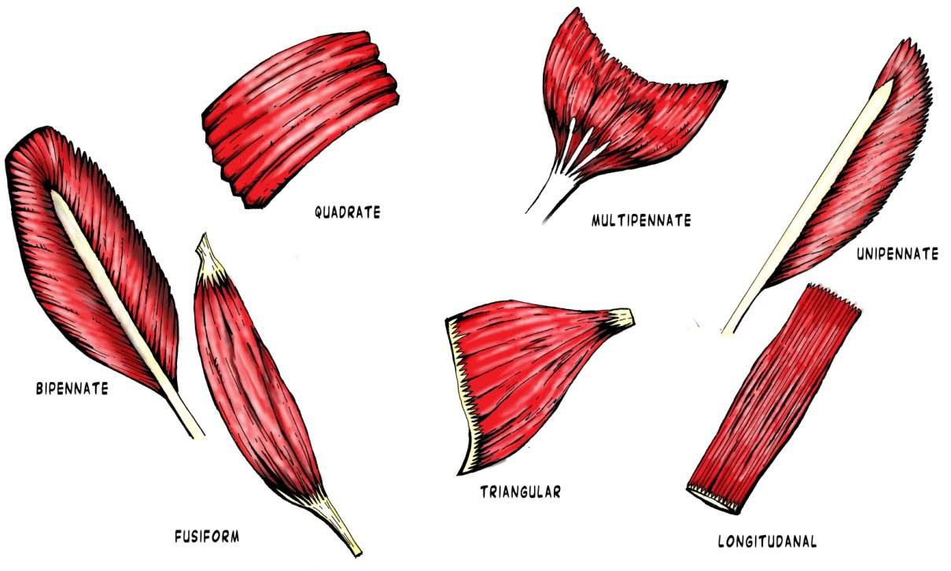

Slide 95
Elongated: length of muscle
Multiple flattened nuclei along outer portion near sarcolemma
Consists of bundles of fibers or myofibrils
Nerve connection to muscle belly is termed motor end plate
Myofibrils are made of contractile proteins actin and myosin
Actin connects to myosin through cross bridges
Muscles working together to produce movements are called synergists
Muscles that produce opposing movements are called antagonists

Slide 96
Nerves and muscles meet at the neuromuscular junction.
Acetylcholine is initially released by the axon terminal into the synapse, where it then targets the target sarcolemma receptors. This then stimulates the release of calcium, which causes the thick (actin) and thin (myosin) myofibrils to slide across one another.
1. Motor nerve cell (neuron) carries stimulus to motor end plate.
2. Acetylcholine (ACh) crosses the neuromuscular junction and stimulates sarcolemma.
3. After ACh reaches muscle fiber, it stimulates a release of calcium in the cell, which trigger action of the troponin and tropmysin.
4. Cross bridges pull thick and thin myofilaments over each other, shortening the length of entire fiber.

Slide 97
A muscle’s rate of contraction depends on the level of myosin ATPase (which breaks down ATP for energy). The more of this enzyme found within the muscle, the faster the contraction.
A neuron can innervate up to one hundred muscle fibers.
Force is generated in two ways: 1) increasing the amount of motor units firing; 2) increasing the speed of neuro-motor stimuli

Slide 98
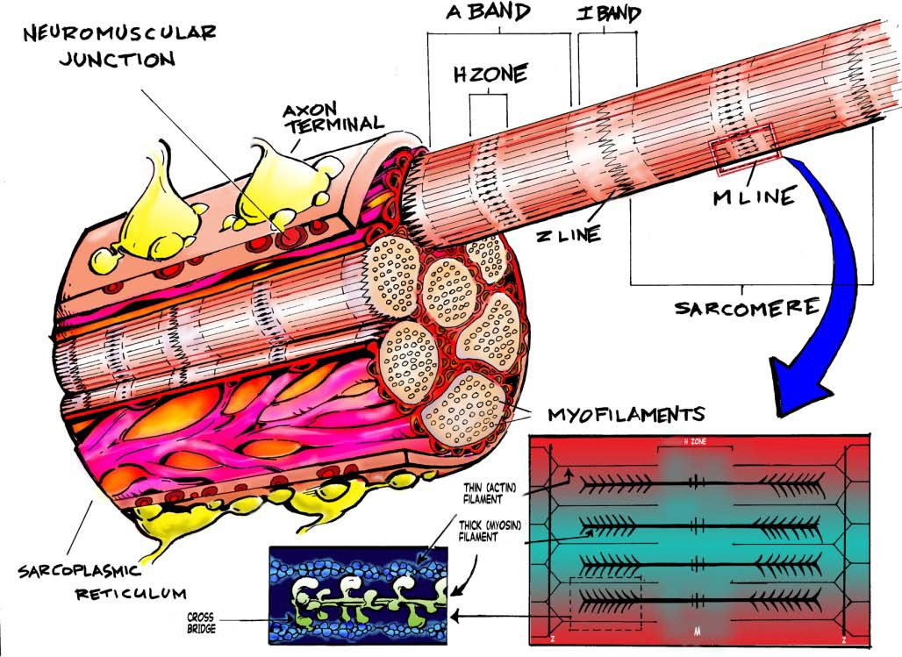

Slide 99
Concentric Contraction- Muscle contraction as fibers shorten; usually active, voluntary
Eccentric Contraction – muscle contract as fibers lengthen; usually involuntary in order to protect the joint; usually antagonistic which is to decelerate the agonist
Isotonic Contraction – muscle contraction with movement around the joint
Isometric Contraction – muscle contraction with no movement around the joint
Isokinetic – muscle contraction at a constant velocity; such as pushing an object that cannot be moved

Slide 100
Agonists- Muscle performing a particular action
Antagonists – muscles that act in opposition to the movement generated agonist; responsible for returning a limb to its initial position. Reciprocal inhibition or forced relaxation due to tight agonists
Antagonistic Muscle Groups – pectorals/latissimus dorsi; anterior/posterior deltoids; left & right external obliques; quadriceps/hamstrings; biceps/triceps; forearm flexors/extensors
Synergists – smaller muscles providing assistance to the larger working muscle groups
Stabilizers – muscles providing stability in order for the agonist to perform

Slide 101
Greater injury occurs during the eccentric phase of a movement due to the overload that occurs either at the muscle belly or musculotendinous junction. Often, the rapid overload overwhelms the muscle and results in a strain or tear due to lack of ability to maintain proper function.
Often not receiving its recognition as a highly valuable component of the muscle, the connective tissue fascia that surrounds each part of the muscle is what makes the human body a system. Volumes of literature have been published examining what are called fascial chains, which delineate how the connective tissue of the muscle is continuous from head to toe. It sends impulses and is highly responsible for muscle performance and nerve conductivity.

Slide 102
For individual muscles, the connective sheath that surrounds the entire muscle group is known as the epimysium. Within, there are more layers of connective tissue. The perimysium surrounds each motor unit, and the endomysium surrounds each muscle cell fiber. Found in the red fiber type muscles in greater numbers embedded in the connective tissue are capillaries. These are used for the diffusion of oxygen and nutrients to the muscle via the blood supply.
Fast twitch fibers have very limited numbers of capillaries due to the nature of the fiber’s function. Fast twitch fibers are anaerobic in nature, and require little to no oxygen during function for energy production. The diminished amount of capillaries, as related to slow twitch fibers, allows the fiber to produce a large amount of force for a short duration.

Slide 103
Motor Units- A single motor neuron plus all the muscle fiber to which it connects
Muscles store a substance called glycogen. During activity, or energy requirements the body utilized this stored substance which is converted to ATP, for energy.
Based upon daily activities, our muscles are always working so that we can accomplish the tasks at hand. When exercising, it is quite noticeable the difference in effort exerted between light and heavier weights. As a general rule, only the minimum number of motor units required to move a given weight will contract in performing work. The immediate involvement of varying numbers of motor units based upon the amount of weight moved is one form of motor unit recruitment. Immediately providing extremely heavy resistance will insurance an earlier recruitment of white, fast twitch motor units.

Slide 104
It is possible to increase the contractile speed recruitment through training. Compensatory acceleration training, plyometrics, or performing Olympic style lifting will increase the contractile speed recruitment.
Heavy weight, low repetition movements designed for speed and strength trains the neuromuscular system. This type of training develops the firing rate and efficiency of the nervous system.
Myofibril Failure – 4-6 reps
Heavy resistance contractions in the 4-6 rep range are good for developing strength, but can eventually cause damage to the myofibrils. Eventually these microtears can lead to future injury in the cartilage, ligaments, and tendons. If heavy weights are used too often, and joint tntegrity becomes compromised as a result.

Slide 105
Failure in this range occurs when the contractile components are failing at or about the same time as the short-term energy stores are depleted. Adaption in this rep range will result in the building of new myofibrils and mitochondria, especially in the red, fast twitch motor units.
Mitocondria failure will result in adaptation through the increased storage of energy, and the building of new mitochondria; which would be beneficial for endurance-based goals
Strict isolation is an anatomical impossibility since one muscle group cannot function on its own.
Body types and muscular development are solely based upon genetics, which it is why it is difficult to try to alter muscles to a certain degree through exercise. While training target areas and movement types can elicit change, composition is solely based upon one’s DNA.

Slide 106
isolation work has its purpose in specific situations. In an injury occurs and a muscle needs to be rehabilitated, or if there is a weak or lagging area that affects larger movements negatively can isolation work be used.
The heart will adapt to resistance exercise in much the same way that skeletal muscles do; if the heart is forced to pump against an increased amount of resistance for prolonged periods, the cardiac tissue will mostly adapt by increasing in size and strength
Cardiac muscles and smooth muscles are both controled by adrenal hormone stimulation, and autonomic and sympathetic nervous system stimulation

Slide 107
Different activities fatigue the body in different ways based upon the intensity of the effort, and the energy system used to perform that task.
The body produces energy through the conversion of macronutrients into the simple sugar, glucose, which is thereafter altered to for ATP, an enzyme responsible for energy reactions.
Different sports have different energy requirements, and based upon the metabolic demand of the sport, athletes should train in environments that most closely resemble or mimic the condition of the sport so as to increase performance.

Slide 108
Bioenergetics- refers to the metabolic pathways from which energy is made available for muscular contraction or work
3 main macronutrients:
Fat
Protein
Carbohydrates
When in excess, glucose is stored as glycogen in the muscle and liver or as body fat.
Protein is essential for muscular growth and cellular repair. It has a low contribution in terms of energy than carbohydrates and fats.

Slide 109
ATP(adenosine triphosphate) is a complex compound stored in all cells, particularly muscle cells, that is required for the biochemical reactions of muscle contraction to take place. It comes from metabolizing energy sources.
Creatine phosphate (CP) is a chemical compound stored in muscle and is important for replenishing ATP after the initial stores are exhausted.
3 Metabolic Pathways:
Oxidative
Glycolytic
Phosphagen
The phosphagen system is active from rest to the beginning of all exercise and is an instant source of ATP. It provides energy at a very high rate bu tonly for a minimal duration of time. In this system, phosphate from CP is transferred to ATP to be used as a source of energy

Slide 110
When exercising this energy system, rest periods should be about three to five minutes long, which allows for the system to fully recover ATP.
Glycolysis is a system that focuses on the breakdown of glycogen to create the high energy phosphate ATP. The sarcoplasm (cytoplasm of muscle cell) is where the steps and reactions of glycolysis take place. Byproducts of these reactions are pyruvate and lactate.

Slide 111
Aerobic glycolysis/slow glycolysis is the process where pyruvate is transported to the mitochondria for use in the oxidative system. It is primarily used when there are adequate amounts of oxygen present within the mitochondria and the individual’s energy demands are moderate to high
Anaerobic glycolysis/fast glycolysis uses pyruvate and converts it to lactic acid; the end product is ATP at a higher rate. This branch of the glycolysis pathway primarily functions when there is an intense demand, although sub-maximal, and high-energy is needed and there is a limited or reduced level of oxygen in the cells

Slide 112
Oxygen needs to be present for slow glycolysis to work.
Fats and carbohydrates are the main power source in the aerobic system. This system functions entirely in the mitochondria and with the presence of oxygen.
Fat is the macronutrient that is used as the primary energy provider after 90 minutes of continuous aerobic exercise.
The Krebs cycle provides our bodies with energy via recycling and production of ATP. Krebs cycle is a portion of the oxidative pathway in which a series of chemical reactions in the presence of oxygen produce energy in the musculoskeletal system. Although the cycle does not actually use oxygen, the ends products are extracted in storage within the cycle. One glucose goes through the Krebs cycle to produce 38 ATP units.

Slide 113
Lactic acid is a byproduct of pyruvic acid and is produced from the breakdown of glucose.
Lactic Acid - a chemical byproduct of pyruvic acid; produced from the breakdown of glucose.
Pyruvate - produced by the breakdown of glucose during glycolysis and is later broken down further for the production of ATP.
Adenosine Triphosphate (ATP) - compound used for all energy requiring actions within the body
Creatine Phosphate - chemical compound stored in muscle that is important for replenishing ATP after the initial stores are exhausted.

Slide 114
Aerobic - aerobic energy systems refers to systems that need oxygen to function
Anaerobic - anaerobic energy systems do not need oxygen to produce energy and/or function
Glycogen - the principle storage form of glucose and is mainly found in the liver and muscular tissues
Metabolic Acidosis - condition in the body when the pH is lowered because of the exercise. This decrease in pH can diminish the work rate of the cell’s energy system.
DOMS - delayed-onset muscle soreness; muscle soreness that usually occurs 24-48 hours after exercise

Slide 115
CP CP CP CP
The length of time the exercise is performed, the level of energy expenditure, and the availability of oxygen all influence the predominant energy system during a bout of exercise.

Slide 116
Sprints/bursts/repetitions - football/basketball
Strength/power - wrestling, UFC training
Endurance - long distance runs
Cycling - Squat 3x25 / 1 leg dl 3x 20 / Rows 3x20 / Press 3x20
Wrestling - Squat 3x10 / Lunges 3x10 / Pull downs 3x8 / Rows 3x8 / Glute bridges 3x8
Olympic lifting - Snatch 6x1 / Snatch pull 4x2 / Push press 4x4 / Rows 3x6

Slide 117
General Exercise Guidelines - Don’t eat two hours before vigorous exercise; drink plenty of fluid before, during, and after a workout; adjust activity according to the weather and reduce it when fatigued or ill. When exercising listen to the body’s warning symptoms and consult a physician when experiencing unexpected problems.
Warming up and cooling down are important parts of any exercise regimen. Warm-up exercises aid the body in making the transition from rest to activity and can help prevent soreness or injury. Cool down exercises help in the same way during the transition from activity to rest.

Slide 118
Individuals with pre-existing physical conditions can exercise but trainers need to be aware of the condition and know contraindications.
Trainers need to be familiar with specific conditions. Understanding specific conditions can prevent injury and help improve the client’s quality of life.
All pre-existing conditions need to be considered when training so as not to injure the trainee. Exercise prescriptions should be tailored around the condition and the goals of the individual to maximize improvement and maintain a safe training zone for the trainee.
Progressions - advancements in exercise/movement difficulty based on a trainee’s ability to perform similar exercise movements.
Contraindication - movements/exercises that should not be performed due to a certain condition

Slide 119
Prior to training any client that has a known or affirmed condition, a trainer must be informed of any an all conditions and have the trainee sign a waiver of liability.
As a trainer, it is very important to recognize and understand issues that
individuals will present. The following list of conditions below is common
complications trainers experience:
Spina Bifida - birth defect caused by an incomplete closure of one or more vertebral arches of the spine. There are different levels of severity from benign to life threatening
Contraindication - extension & neutral spine

Slide 120
Spondylolisthesis - translation of a superior vertebrae in relation to its inferior segment; most commonly occurs in the lumbar spine
Contraindication - avoid lumbar extension; flexion feels okay but may make things worse
Stenosis - abnormal narrowing in anatomic tube structure; spinal stenosis is the narrowing of the spinal canal or intervertebral foramena and is usually accompanied by neurological symptoms
Contraindication - slight flexion feels better but may make things worse
Herniated Disc - pathological condition in which a tear in the outer, fibrous ring (annulus fibrosus) of an intervertebral disc allows the soft, central portion (nucleus pulposus) to be extruded towards the outside
Contraindication - spinal sparing techniques, core stabilization, balance and proprioceptive training. Important to work within the client’s boundaries

Slide 121
Spinal Fusion - also known as spondylosyndesis, is a surgical technique used to fuse together two or more vertebrae
Contraindication - avoid excessive end-range motions of the spine, particularly in flexion and rotation
Antaglia - means leaning away from pain; antalgic leaning patterns present in any plane of motion
Contraindication - recipe for repetitive stress injury because your gait is off. ain may start on opposite side
Impingement - refers to closure of a space through which a nerve, tendon, or blood vessel may run causing friction and disrupting the structure’s movement or position
Contraindication - any exercise or movement that a client is precluded from doing due to an injury; other exercises to that area may be done however there are limitations

Slide 122
As a trainer, impingements will be very common amongst trainees. Due to
postural defects, past injury, or repetitive actions, many individuals suffer from this minor condition. While many impingements are minor in nature, some can be more serious if the impingement is occurring at a nerve. Nerve impingement should be addressed with neural flossing and glenohumeral impingement should be addressed with scapular stabilization. Flexibility of the prime movers should be enhanced for both situations.
While studies by the noted Dr. Stuart McGill have found that the majority of back pain is muscular in nature, there are many conditions of the spine that can and do lead to back pain.

Slide 123
Hyperlordosis
Hyperkyphosis
Hypolordosis
A pelvic tilt is when the position of the pelvis (determined by the ASIS) is deviated away from the norm.

Slide 124
Stretching allows us to increase the length of the muscle to improve movement patterns, or to relax the muscle and alleviate tension after training.
Stretching is a very important tool as it allows trainers to improve the ability of each individual to complete daily tasks with less pain and difficulty, as well as perform well in sport.
All stretching of the muscle is a product of the length that the brain determines the muscle to be at during either rest, or movement.
Hypertonic - a hypertonic muscle is limited in its ability to contract and lengthen properly, causing inefficient movements and joint stress
Stretch Reflex - the neurological process with which the body reacts to a sudden change in the length of a muscle

Slide 125
Autogenic Inhibition - the neurological process whereby proprioceptors (golgi tendon organs), located at the musculotendinous junction, detect an increase in tension in that muscle; when a specific amount of tension is detected the muscle is then inhibited in the spinal cord preventing it from contracting. As a result the muscle relaxes.
Reciprocal Inhibition - the process by which the contraction of an agonist muscle neurologically inhibits the contraction of the antagonist muscle
Our bodies are designed to mov at the joint. Being said, each one of the body’s joints has a given range of motion that is based upon the material and shape of the joint surface, and the muscles that connect to those joints. Limited ranges of motion occur due to tight muscle. Problems arise when shortened muscles affect the joint’s ability to function during exercise, leading to faulty movement patterns.These problems lead to performance at a less-than-optimal level as performance, as well as possibly increased risk of injury

Slide 126
Instances occur when decreased ranges of motion are beneficial in situations where excessive lengthening can decrease performance such as a sprinters and their trunk musculature.
Everyone has seen people stretch before an activity. Muscle injury (strain/tear) rarely occurs in the end ranges of movement, discrediting the notion that it prevents injury.
Scientific evidence demonstrates that static stretching of muscle decreases isometric and dynamic muscle strengths at different velocities. Isometric strength is important for stability during complex movement. Dynamic strength has obvious importance when it comes to actual movement

Slide 127
Our muscles stretch because of two factors. Muscle & tendon allow muscles to lengthen. Neural responses elicited from activities determine a muscles length - in other words, we are what we do. When static stretching these two facrtors can have a negative effect on exercise due to neuromuscular. Prolonged stretching can make the muscle and tendon overly compliant. It is important to have plenty of stiffness to develop force in a muscle. This allows for better use of stored, elastic energy in the muscle and tendon and ensures that everything lines up properly at the level of muscle fibers.
It is acceptable for static stretching after each workout or on recovery days. Static stretching has benefits to exercise in that it can be used to relax hypertonic muscles to help underperforming muscles better activate.

Slide 128
There are three neuromuscular components to stretching. The stretch reflex, or stretch cycle/shortening cycle, autogenic inhibition, and reciprocal inhibition.
Stretch/shortening cycle (SSC): The elastic energy that is generated and
stored to produce greater force production. It is caused by a rapid
elongation and contraction of a muscle, sensed by the muscle spindle.
Autogenic inhibition: When a muscle is activated and then stretched
with the effect being that the muscle is lengthened.
Reciprocal inhibition: When an opposing muscle is activated and causes
the opposing muscle to relax and lengthen.

Slide 129
Stretch receptors (muscle spindles) are located within the sarcomere, or muscle
cell. These receptors are used to help the brain determine the muscle’s activity by monitoring length and tension. They are helpful in creating a rebound effect in sports (as in a countermovement jump), as well as protecting the muscle and tendon from injury.
Autogenic inhibition occurs when a large amount of tension is applied to a muscle for a prolonged period of time; such as when static stretching a muscle
The negative effects that reciprocal inhibition may pose to the body are they contribute to muscle imbalances; if an agonist muscle is hypertonic(overactive), its antagonist muscle will be inhibited causing lengthening and a decrease in functional control.

Slide 130
Static Stretching - slow stretching that involved holding the end point of tension for 20-30 seconds and targets the passive elastic component of the muscle; examples include the hip lunge and standing hamstring stretch
Passive Stretching - achieved by having an external force, such as a partner’s push, wall, or use of the floor or machine, applied in order to attain and hold the end position.
Active Stretching - uses agonist muscle contraction in order to stretch antagonist muscles; this type of stretching uses the principle of reciprocal inhibition.
Dynamic Stretching - uses active contraction of the anagonist muscle (creating motion) in order to produce a stretch to the agonist muscle

Slide 131
Ballistic Stretching - involved active motion through a joint and creating a bouncing motion at the end of the stretched tissue
Many studies have been published examining dynamic stretching in athletes. It has been found that dynamic stretching uses an active contraction of the antagonist muscle to stretch the agonist muscle. This method can be used as a warm up to increase muscle temperature and lower viscosity between muscles.
Of the recently published studies, researchers found that subjects performed better and were able to generate more force by using a dynamic stretching protocol. Dynamic stretching uses rhythmic contraction of the antagonist (creating motion) in order to produce a stretch to the muscle.

Slide 132
Ballistic stretching is associated with injury and is only recommended
under careful guidance of a professional. Repeatedly forcing a joint or soft
tissue through its end range could cause irreversible laxity and instability
in the non-contractile tissues of the joint. Ballistic stretching could also
activate the stretch reflex, which would in turn cause the target muscle to
respond by contracting or tightening.
PNF Stretching - PNF (proprioceptie neuromuscular facilitation) stretching includes four different types of stretching techniques that combine muscle contraction and relaxation in order to relax an overactive muscle and/or enhance the flexibility of a shortened muscle.

Slide 133
A trainer would use a PNF stretch for the following: 1) Target muscle is placed in midposition 2) Patient contracts isometrically for 10 seconds using maximum strength 3) Relaxation phase, client is instructed to relax as trainer stretches the muscle 4) Stretch phase, muscle is held at new barrier for 10 seconds 5) Repeat at new barrier
PIR Stretching involves initially bringing the muscle to resistance followed by 10-20%. Isometric muscle contraction by the client.
Reciprocal inhibition is the neurological mechanism PIR uses with agonist contraction.
Studies have suggested that actively stretching allows the client to feel as if they have more control, and as a result are more willing to extend their tissues into greater range

Slide 134
Minor strains are usually the result of either an over-stretch or rapid contraction. Muscle imbalances caused by overactive or hypertonic muscles, lead to strain. The muscles become overworked since the antagonist is under performing due to the body’s response of reciprocal inhibition.
In actuality, cramps have been found to be primarily a neurological activity in which the motor neuron that controls a muscle fiber fires at a high frequency which causes an involuntary contraction.
Dehydration is one of the most common reasons for muscle cramping. Always have consideration for client’s water intake prior to training. Other causes of muscle cramps include heavy exercise, pregnancy, hypothyroidism, depleted magnesium or calcium stores, or other metabolic abnormalities, alcohol consumption, kidney failure leading to uremia, medications, muscle fatigue

Slide 135
Fasciculations are single, involuntary firing of motor neurons that will cause brief twitches in the muscle fibers that they innervate. These twitches usually are low in intensity and will usually not produce motion at the joint.
Most fasciculations are benign and do not indicate pathology.
Minor fasciculations can be the product of stress however, more serious fasciculations have underlying causes. Motor neuron disease or denervation due to radiculopathy, that are usually accompanied by weakness and atrophy of the affected muscle group.

Slide 136
Dynamic:
high knee
butt kicker
carioca
power skip
bounding
Static:
quad stretch
toe touch
leg cross-over
adductor stretch

Slide 137
Core training the creation of stability on one’s trunk through exercise protocol that creates strong stabilizing muscles of the spine and pelvis. Core training is vital as it allows for injury prevention, force transfer, and increased range of joint motion. Abdominals, erectors, latissimus dorsi, gluteal group are all muscles that comprise the core.
The core is where most of the body’s power is derived. It provides the foundation for all movements of the arms and legs. Consider the core similar to the frame of a car. It needs to be strong and stable so that energy can be directly transferred to the wheels for movement. The muscles of the core need to work together, or synergistically to stabilize and prevent injury.
The muscles of the core are not limited to the abdominals alone; rather, they
consist of back muscles, spinal stabilizers, fascia, and deep muscles.

Slide 138
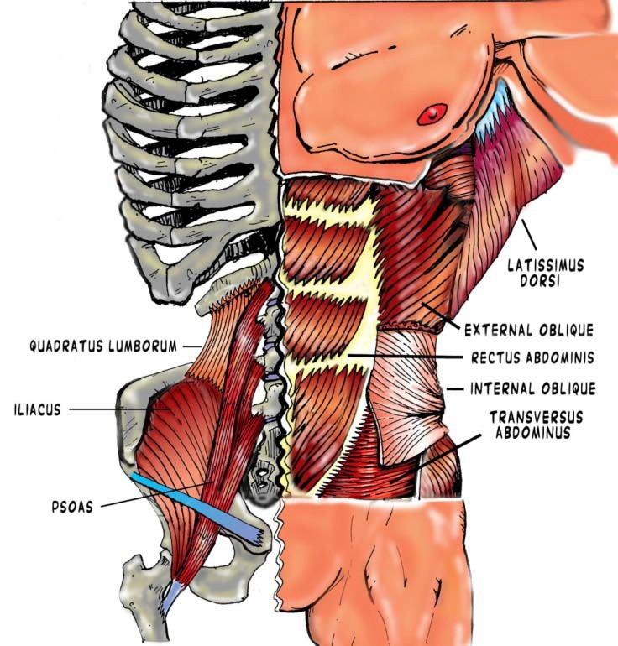
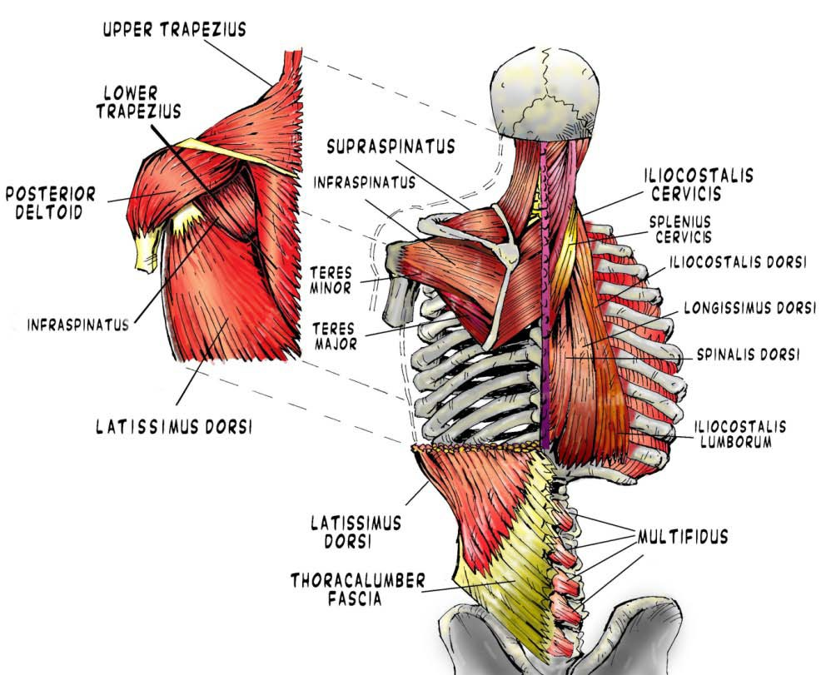
Now that the muscles of the core are identified, it is also important to understand that their function is to protect and maintain the position of the spine. That is essentially the definition of what a “strong core” is. While beneficial to have a strong rectus abdominus, or strong erector spinae, if they cannot work together to stabilize the spine, structural integrity will be compromised and the potential for injury is drastically increased.

Slide 139
To achieve a balanced and core capable of supporting the spine correctly, any
training routine should include dynamic stabilization so that increased
proprioception and trunk stability will allow the rest of the body to perform as
designed. A proper core routine consists of dynamic movements, proprioceptive, and isometric exercises. To completely train the core, the
previous movements should be exercised in a variety of positions to challenge the center of gravity and proprioceptive ability during functional tasks.
Floor exercises, where the trainee is laying supine, are not beneficial for training the core. An efficient core routine consists of multiplanar movement training in all planes of motion. Dynamic stabilization must be included to increase proprioception and stability in the trunk and rest of the body.

Slide 140
Dynamic stability is best achieved through training in functionally practical
positions that mimic activities or movements in particular sport or daily
activity. It is referred to as dynamic stability because it is stability that is needed for movement.
A weak core contributes to poor stability and inhibits proper limb movement causing muscle imbalances to the kinetic chain.
Back injury is usually caused by poor stability, inhibited proper limb movements, and muscle imbalances in the kinetic chain; all of which is due to a weak core.

Slide 141
Dynamic Stabilization - refers to exercises that target your core musculature by keeping your trunk steady while you move one or more of your extremities
Kinetic Chain - chain of musculature within the body that allows for all movements
Core Progression - further challenging the client’s core once they have mastered a particular movement
It is important to challenge the client enough to make improvements but only when they are capable of those movements in order to avoid injury.
Plank progression - wall plank, knee plank, knee plank with balance pad under feet, knee plank with roller under arms, knee plank roller under arms/pad under feet, full plank, full plank with pad under feet

Slide 142
When putting a client though various progressions of specific exercises, a
trainer should use good judgment when progressing to a more complicated stage of an exercise. A client should be proficient with the
current stage of the progression and exhibit particular strength and proficiency to warrant greater challenge.
Faster movements necessitate a strong, dynamically stable core to
transfer the force of that movement without a break in the posture or
form that needs to be maintained during the particular movement
The major difference between power and strength is the speed of the
movement, rep range and the recovery time needed before the next set.

Slide 143
Sitting is one of the biggest postural detractors, and core-destabilizing positions a person can maintain. The way in which we go about our daily lives affects our bodies as the human body always adapts to its function. Spending long hours at a desk and driving will find the body adapting to those relaxed, seated positions. By explaining pelvic tilting and how it affects muscle activation in the core and how it relates to movements.

Slide 144
For cyclists and runners, a strong core is vital to performance. Observing top-level athletes in both sports, one would notice that they all look balanced and with proper postural positioning. Conversely, observation of recreational runners or cyclists will find that there are multiple postural defects as a result of the person’s training, as well as their daily activities. Top level cyclists and runners spend their time under the careful scrutiny of a coach and under an individualized training plan. Recreational athletes are often engaging in these sports without long-term planning or preparation specific to individual needs. Often, the posture of recreational runners and cyclists is kyphotic due to weak musculature of the upper back and poor position maintained during each activity

Slide 145
Problems Associated with Core Function
Over-pronation - in lower extremities (rolling in as the arches collapse) a series of biomechanical imbalances
Excessive hip adduction - due to tight hip adductors and can cause increased load in the lateral tissues, such as the iliotibial band, tensor fascia lata, and gluteal medius
Lack of trunk rotation - restrictions in trunk rotators or shoulder extensors; this can cause an overload in the hip musculature, spinal joints, and other trunk rotators

Slide 146
Problems Associated with Core Function
Lack of Hip Extension - caused by hip flexors restricting extension, and weak gluteal muscles; this causes the extensors and rotators of the lumbar spine to become overloaded in order to compensate for the lack of hip extension
Lack of Shoulder Extension - caused by restrictions in anterior shoulder muscles or poor trunk rotation
Think of the body like a series of balanced pulleys: each limb as an equal and opposing muscle group (agonist/antagonist relationship) that allows for there to be balanced function of the limb and joints. Any muscle combinations that have an unequal tension balance will cause imbalances and joint dysfunction

Slide 147
Anterior Pelvic Tilt - position of pelvis is determined by the ASIS, which is pointed anteriorly (forward). This is usually with hyperlordosis, or hyperextension, of the lumbar spine; the glutes usually stick out
Posterior Pelvic Tilt - position of pelvis is determined by the ASIS, which is shifted posteriorly (back). This is usually associated with hypolordosis, or flexion of the lumbar spine; belt buckle is up towards the belly button
Neutral Spine - midway balanced point of the spine that requires the least amount of muscular contractions

Slide 148
Neutral Spine
Anterior Tilt
Posterior Tilt

Slide 149
Tight hip flexors can cause an anterior pelvic tilt and weak hamstrings, tight erectors and a weak rectus abdominus might all be causes of an anterior and posterior tilt.
Hypothetical Client:
Jeff is a 47 year-old male looking to get into better shape. He works at an office and sits at a desk at least six-hours a day. His workout routine consists of light cardio, and a round on the gym’s machines. Jef complains of lower-back pain, and wants to become stronger and gain more mobility. During assessment, the trainer should look at Jef’s mobility and movement patterns to determine areas that need specific attention to improve mobility and prevent injury. Simple assessments such as planks or glute bridges can be a good tool to assess foundational core strength. The remedial exercises to prescribe during sessions and at home - Core stability, upper back stretching, hip flexor and hamstring stretches both dynamic and static.

Slide 150
Foam rollers are cylindrical tubes of foam about 3” in length
They have purposes for trainers to use them in that they are used for myofascial release and massage of soft tissue
All of the body’s muscles are encased in fascia, making them similar to a series of sausages in our body. During movement, muscles slide past each other. Between them is a gel-like lubricant between them to prevent the fascia from binding. Due to exercise, injury, or even diet, waste products build up between the muscles. The collection of waste products develops what are called adhesions, which can become detrimental to muscular performance by limiting the range of motion of a muscle, or causing spasms. When these types of build-ups occur, scar tissue can develop painful points along the fascia. These points are known as trigger points, they restrict the amount of blood flow to the muscle, cause the muscle to shorten in length, and increase the amount of tissue inflammation.

Slide 151
Myofascial - refers to a layer of fascia that surrounds muscles and divides groups of muscles into compartments
Trigger Point - structural imbalances, excessive scar tissue, trauma from injury, and painful points along a muscle or in the fascia that cause a restriction in blood flow to the muscle, shortening the muscle, and possibly inflammation and pain.
Range of Motion - refers to the distance and direction a joint can move between its two extremes
Fascia - a structure of connective tissue that surrounds muscles, groups of muscles, blood vessels, and nerves

Slide 152
Similar to a massage, foam rollers can help break up adhesions and scar tissue. While foam rollers are unable to work as deeply into tissue as manual therapy, they still are quite proficient at breaking down minor scar tissue and adhesions to help restore muscles to length and function. Foam rollers help restore muscles to their natural length and function which helps rid
the body of muscle imbalance and dysfunction, Dispel adhesions, work scar tissue free, improve blood flow, and restore a muscle to its original length via trigger point release.
Aside myofascial release, foam rollers are also advantageous to trainers in that they are another tool to use for exercise. Used to help re-train the CNS to perform proper movement patterns, foam rollers can be use for a variety of exercises for a variety of individuals.

Slide 153
Some benefits that training with foam rollers offer:
break down scar tissue
disperse adhesions
increase blood flow
lengthen muscles
activate a muscle
Foam rollers are useful on clients both at the beginning and the end of sessions. Foam rollers can help muscles function properly before activity and return them to their normal functioning after activity.
Using foam rollers to keep a neutral spine during supine exercises is most
beneficial for clients that have a weak/unstable core and issues with their lower back.

Slide 154
Using a foam roller against a wall as support will not only give the client support they need but also give their upper body the guidance of how it should move during the squat.
If a client experiences limited hip mobility, suggest foam rolling the glutes, hamstrings, hip flexors, and gastroc/soleus.
Proprioception is when the body can sense its position in space without the use of sight.
Foam rollers can be used to train proprioception by challenging balance and core musculature during various exercises.
Proprioceptive training benefits include increased balance and dynamic stability during all movements

Slide 155
As people age daily activities that require vigorous use of stabilizer muscles
decline, as does the use of full ranges of motion. As well, the arrangement of fibers within the muscles fascia begins to lose the elasticity due to either age or a sedentary lifestyle. Foam rolling daily can help maintain the integrity of the fascia, and keep beneficial ranges of motion.
Program Design using foam rollers to train a female trainee in her mid-sixties. She has limited mobility in her hips and back, and upon assessment, her core is lacking in stability.
3x10 for all exercises
wall squats
roller press (lat)
stretch
glute bridge
dead bug

Slide 156
Programming is vital to the training process as it allows the trainer to
monitor the progress of an athlete and prevent overtraining, as well as
plan the proper progression of exercises and improvements.
Programming is the careful design and prescription of exercises, volumes
and intensities to adequately stress the trainee to elicit improvements to
reach desired goals.
In order to design a successful fitness program, it is essential to establish and
understand the primary intent of a training program. Each training program should consist of different phases so that the trainee can be consistently challenged through overload in order for adaptation due to stimulus to occur.
Each phase should be a continuation of the last with changes and variations in tempo, intensity, rep ranges, and rest period.

Slide 157
Programming - creating an exercise plan that should include phases or cycles in order to obtain consistent challenges and overloads for the client.
Volume - refers to the number of muscles worked, exercises, and sets
Intensity - refers to the amount of work required to achieve the activity and is proportional to the mass of the weights being lifted
Periodization - the modulating of volume, intensity, and frequency over time to both stimulate gains and allow recovery
Overload principle - states that gradual increase of stress placed on the body during exercise training will stimulate gains

Slide 158
The principle of overload in relation to variations allows for stressors to be placed upon the body so that it can adapt and improve to those stressors placed upon it. Variations also allow for recovery over time so that the body does not advance into an overtrained state and can adapt and improve to the stress it undergoes.
Prior to developing any specific or detailed training program, it is important to
understand what the trainee is looking for, as well as what the trainee needs.
Before any plan is designed, the first thing a trainer needs to do is evaluate the trainee.
It is necessary to conduct this process because a trainer must know what muscle imbalances and problems a client may have. It is important to know any contraindications for the client based on the imbalances.

Slide 159
Any weaknesses and imbalances should be addressed and considered a main focus when designing a program, as every program should focus not only on goals of the trainee, but function too.
Exercises should always be geared toward function and translate to the sport or activity of the trainee. If an exercise in not specific to the needs and goals of the client, the improvements desired to be made in that sport or activity will be negligible and have minimal transfer. The idea of transferable movements
is to improve performance for the specific activity and prevent injury.
Evaluations help with program design because rcise prescriptions and programs should be based on should be based on the client’s goals and what muscles/muscle groups need to be worked on for that client.

Slide 160
Generally, evaluations between beginnings and advances athletes
should be similar: they are all designed to determine weak points in the individual that need to be corrected or improved.
Heavy weight training or explosive movements should always be avoided with beginners.
With beginning clients, performing more sets of lower reps is better because it
increases motor skill development. This is because clients must master the basic movement before being able to progress to more difficult strength and/or power exercises.

Slide 161
To teach and reinforce proper form, follow this basic guideline for a program:
Minimize the amount of exercises to be performed each session
Teach proper mechanics through repetition
Include full-body movements as the progress from body weight to added resistance.
Phases should last anywhere between two and six weeks depending on exercise frequency, client progression, and goals.
In a program, basic structure and consistency need to be maintained
so that the trainer can monitor the trainee’s progression. Variation is important
to a training program, too; however, there are specific variables that need to
be changed.

Slide 162
Specific variables that need to be changed within a training program:
Rep range, tempo, rest periods, sets, reps, load, intensity, volume, and duration
Progress needs to be measured in order to realize whether or not an exercise program has been effective or not.

Slide 163
Serious Athlete:
Needs strict attention and exercise selection must be precise
Super sets, dynamic core training, plyometrics, and heavy training
necessary
Need to be coached very well/told when doing anything wrong
Recreational Athlete:
Progression is important, these individuals want to be challenged and exposing their weaknesses will fuel their determination
Should train with weights 3 times a week
Usually has some gym experience and will want to do non-
functional exercises for enjoyment but will do all sport- specific exercises you teach

Slide 164
Exercise Enthusiast:
Lives to exercise and will stop at nothing to get into shape
Exercises must be functional and geared towards toning and muscle building
Program design should include 4-5 days
Weight Loss:
Workouts should be focused on getting them to sweat and raising and lowering heart rate
Exercises should relate to every day activities and gross movements
Circuit training is a good routine for these participants
Gym Hater:
Usually will not do anything unless they see you
Do not want a hard workout and anything beyond simple exercises makes them upset
Best routine is circuit training but try and keep it fun and do your best to keep them motivated

Slide 165
The role of the trainer when designing a program is to provide useful and functional exercises for each client while keeping them motivated throughout their workouts.
Having established the different types of trainee that will be experienced, it is
important to keep in mind how they are to be trained. The majority of those who
seek trainers will not be the aspiring athlete, rather, fat-loss clients. One of the best ways to help these clients achieve their goals is though utilizing circuit training in their program. Circuit training involves performing a series of exercises with little to no rest between each exercise
There are as few as three or as many as six exercises performed consecutively in a circuit routine

Slide 166
The overall goal of circuit training is to allow for anatomical adaptation in a structured manner with a decreased risk of overload due to alternating muscle groups.You can easily control the intensity of a circuit routine by speeding up the exercises,super-setting, varying/increasing or decreasing rest periods
The frequency of a workout is very depending upon the status of the trainee. A novice should be training 2-3 per week while an experienced athlete should be 3-4 times per week.
It is important to remember that a trainee’s progression is based upon their anatomical adaptation. A novice will require about 8-10 weeks for adaptation, while an advanced trainee will require program changes after about 5 weeks due to their advanced physical capacity

Slide 167
The difference in programming between novice and advanced athletes has much to do with the experience and training capacity of the individual. Advanced trainees need more time spent training as their body has reached a higher level of adaptability and needs to be challenged greater.
If a trainee’s program plans for training three days of the week, with one day of rest between each day, describe what the optimal arrangement would be for those three days:
Full body
Core, balance and stability
Full body with small muscle focus

Slide 168
It is important to take into consideration the time of year it is for the athlete because workouts must be based on the time of the year to avoid over-training.
While many sports are similar in their nature of human movement, they all pose different demands on the athlete. Energy systems are important to recognize when designing an athletic program. rainer must create a athletic program design that effectively trains the energy system that is important and relevant for the athlete’s sport.
The 4 periods that athletic programs prepare for:
off-season
pre-season
in-season
post-season

Slide 169
The off-season is usually a time for preparation. Corrective and strength work is the main focus of the program, so that the athlete can improve in lagging areas. Gross movements performed with slower tempo should be used during the first phase followed by gross movements performed with an explosive tempo during the second phase.
Pre-season is when an athlete becomes sharpened prior to the start of actual competition. Programs begin to diverge from a strength focus and incorporate more speed and power movements to help the explosiveness and quickness of the athlete during competition. Power and endurance strength should be used during this phase.
In-season training naturally wants to keep the athlete fresh for game time, so workouts are not too demanding, but more focused on maintaining the gains during the off-and pre-season. Continue explosive lifts but decrease frequency and avoid high risk exercises while keeping workouts shorter and avoiding a lot of aerobic activity.

Slide 170
After a long, rough season, the post-season is a period used for recovery. No direct sport practice is done, but some training is still maintained. Higher reps to encourage recovery, and keep the body conditioned, but nothing of great stress to overexert the body.
When designing a program, goals are the end result. Each person will have different goals, needs, and requirements, with different abilities to achieve them. Programs should reflect the abilities of the trainee, as well as the specific goals, needs, and requirements.
Competitive Athlete:
Duration – 4 days per week
Exercises – Olympic lifts, squats, plyometrics, agility
Intensity – 80-100%

Slide 171
Recreational Athlete:
Duration – 3 days per week
Exercises – squats, general strength work, moderate plyometric & agility
Intensity – 80%
Beginner:
Duration – 2 days per week
Exercises – beginning progressions for all exercises
Intensity – 60-80%

Slide 172
So many of the popular exercises performed in the gym have gained such notoriety from the bodybuilding scene. The era of Arnold Schwarzenegger and body building magazines have created a myth that certain exercises and machines are beneficial to the body.
Many of the popular exercises performed today can actually be hazardous to one’s body and lead to stress related injuries.
Just because something is popular, does not mean that it is worth doing. Many of the popular exercises performed should not be performed at all by a majority of the population, unless a specific need requires that movement.
Since the era of Arnold Schwarzenegger and the rise of “bodybuilding” style routines, people in gyms all over the world perform exercises that in a functional world are as beneficial as people think, and may actually be detrimental to their well-being. Some reasons for not performing specific exercises could be preexisting conditions, postural or muscular imbalances, or simply poor mechanics of movement of the exercise.

Slide 173
Aside true weightlifting gyms, every commercial gym in existence will have machines of just about every variety and for all body parts. Yet, while these machines are designed to work specific body groups or parts, they do not train the body in the most effective manner. Most machines do not train muscles or movements in the way they are naturally meant to. They do not activate stabilizers of specific muscle groups and/or core musculature.
Machines allow trainees that do have not enough stabilizing ability to perform isolated movements.
As discussed in previous chapters, during movement, there are the muscles that are primary movers, and muscles that are stabilizer muscles to help maintain position throughout ranges of motion. Machines have a tendency to minimize the work of these types of muscles since machines have fixed planes of motion/movement.
Front pulldowns are the best option. Behind neck pulldowns create the same stresses and the shoulder girdle as behind the neck press does.

Slide 174
Box squats engage core and leg stabilizers, allow for a more natural movement, and when performed properly protect the back.
Regular barbell bench press is the better alternative. SM press takes the natural motion out of the movement, puts extra pressure on the shoulder joints, and act in a fixed plane of motion.
Split squats are the better choice. Leg extensions activate different muscles of your quadriceps muscle group during different phases of the motion and also put significant pressure on the kneecap and kneecap tendon.
Seated shoulder press is the safer option. Behind the neck press unnecessarily strains your shoulder joints puts increased stress on the AC joint, and increase the risk of cervical spine injury.

Slide 175
Crunch with Dynadisc. Situps results in repeated lumbar flexion, strains the cervical spine, and recruits more hip flexors than abdominals.
Foam roller cross bridge. Leg raises over activate the psoas musculature and may cause low back pain.
Transverse cable chop. Bicycles also over activate the psoas and may cause low back pain. It also strains the neck.
Stability ball crunch. Sit-up machine creates forced lumbar flexion within a locked range of motion.
Alternating quadruped. Research supports that Supermans result in over 1300lbs of compression to a hyperextended spine, loads the facets, and crushes the interspinous ligament.

Slide 176
Wall squats. Hack squats result in patella femoral shear and act within a forced range of motion.
Deltoid Flies. Upright rows create impaired rotator cuff range motion and forced internal rotation. May result in chronically inflamed tissues of the shoulder.
Sumo squat. Adductor machine act within a forced range of motion. It further tightens an already tight muscle in most people and it also places great stress on the lumbar spine
Hip hinge-type movements require a neutral spine in order to avoid unnecessary pressure and stress on the lower back.
A weak core musculature would result in a rounded back during weight bearing exercises that require a neutral spine. A strong and stable core is needed to correctly perform these exercises.

Slide 177
A strong core is a key factor as to whether or not an individual can correctly perform an exercise. A weak core results in compensations and excessive stresses placed on the body.
As a trainer, you need to be able to accurately explain to a trainee how to perform an exercise.
Squat - Center barbell behind the neck across the shoulders and traps. Feet should be about half-way between the shoulders and the weights. Lower yourself under control into the squat by bending the knees and hips until the thighs are parallel to the floor. Return to the starting position by extending the knees and hips
Split Squat - Start with one leg in front of the body keeping the knee and foot in line with hip. Opposite leg should be resting on stepper or bench. Perform a half squat and return to starting position
Deadlift - Bend at the waist keeping spine and neck neutral. Back straight and knees soft while holding the bar with hands about shoulder width apart

Slide 178
Romanian Deadlift - Hold bar slightly wider than shoulder width. Bend the knees slightly, your shins vertical, hips back and back straight. Keeping your spine and neck neutral at all times, use your hips to lift the bar while keeping the arms straight
Good Morning - With barbell on your shoulders, keep your head and spine neutral and bend at the waist until your upper body is just above parallel to the floor. Then return to the starting position
Quadruped Raises - Start on all fours with knees under hips and hands under shoulders. Brace the stomach and squeeze the glutes. Press the feel straight back to straighten the leg while keeping the torso level
Stability Ball Crunch - Place your lower back center of the ball and place your hands behind your head (don’t use your hands to pull) Crunch by bringing lower ribs and pelvic toward each other without rounding your back

Slide 179
Lat Pulldowns - Grasp bar at outer most bend with overhand grip. Bring lat bar to upper chest by pulling the upper arms and shoulder blades downward and back. Maintain the natural curve of the back
Seated Shoulder Press - Sitting tall on a bench or ball, hold weights at shoulder level with palms facing forward. Keep shoulder blades down and back while pushing weights straight up overhead.

Slide 180
Looking through the average gym you will find many people accessorized with various forms of workout attire. Ranging from music sources, knee wraps, wrist wraps, belts, amongst many other forms, but do these accessories serve a purpose? Many people believe so, but in actuality, they may do more harm than good. People become reliant upon wraps and belts, thinking that it helps with their lifting- and in some cases they may- but often individuals develop imbalances because of these accessories.
Cons: Relying on wraps during regular workouts could decree the training effect because the wraps are doing some of the lifting while your muscles don’t. Heavy wrapping can warm your knees too much or conversely the tightness could cut off circulation causing a drop in temperature weakening the muscle tissue.
Pros: Can help protect an injured body part from further injury.

Slide 181
Wrist wraps can cause the same negative effects as knee wraps, however, if someone has had a wrist injury, they can be helpful in maintaining integrity of the joint. They should not be relied upon, though
Weight belts should be used sparingly and only during near-maximal lifts. They are only useful during near-maximal lifting with very heavy weights.
Overtraining is when one exerts themselves beyond the capacity of their recuperative ability over duration of time, which leads to physical breakdown. Markers of overtraining include poor mood, constant fatigue, and soreness. Without proper programming, anyone can overtrain.

Slide 182
Overtraining - A common problem in weight training that occurs when the volume and intensity of the exercise exceeds an individual’s recovery capacity.
Metabolism - The sum of all chemical reactions that occur within the body
Atrophy - The partial or complete wasting away of a part of the body such as a muscle
Symptoms of overtraining:
• Totally run down after a workout
• Experience chronic joint stiffness
• No longer making progress
• Bad attitude towards your workouts
• Experience an increase in body temperature
• Insomnia

Slide 183
Overtraining is detrimental to the body because it causes the following: persistent muscle soreness, elevated resting heart rate, increased susceptibility to infections, increased incidence of injuries, irritability, depression, loss of motivation, decreased appetite, chronic fatigue
Equilibrium- Fully recovered state, where energy is neither being depleted nor replenished and structural tissue is not being damage or repaired
Catabolism- The stage when energy is depleted and tissue damage is taking place
Anabolism - The stage of metabolism when energy is being depleted and tissue damage is being repaired; the most valuable stage of metabolism to the resistance trainee.
The purpose of training is to stimulate tissue growth and adaptation. When a trainee reaches a state of equilibrium, they are fully recovered from the previous training session. When a trainee trains, the stimulus develops a higher degree of ability for the tissue to perform and withstand. When that stimulus is not maintained, atrophy of the muscle will occur, resulting in a reduction in size & strength. .

Slide 184
For an athlete to continually maintain or make gains, equilibrium should be maintained no longer than 10-15 days or atrophy of the contractile proteins will result in gradual muscle tissue loss.
Prior to recovering to a state of equilibrium, the body must first enter a catabolic state through training. Catabolism is the body’s mechanism for energy creation or release during exercise or situations of stress. It is also the stage when energy is being depleted and tissue damage is taking place. Catabolism is not bad unless workouts are too long, or the nutrition of the athlete is not sufficient to meet the demands of training and recovery. At this point, the body will enter gluconeogenesis, where muscle tissue is broken down for energy production. If the body remains in a catabolic state for too long a period, training will exceed the body’s ability to recover, which can lead to an overtrained state.
Proper nutrition will supply the body with the nutrients needed to recover from workouts and keep the body out of a catabolic state.

Slide 185
Commonly known in reference to anabolic steroids, the body naturally maintains an anabolic process. Anabolism is the friend of a trainee, as it the stage of metabolism that helps to replenish energy stores, and repair damaged tissue. After training, nutrition is vital to the recovery process, and many studies have found that consuming a mix of carb/protein will aid in the process of cell recovery. These nutrients are vital due to the inflammatory state that body will enter after the breakdown of muscle and other cells. Without the proper nutrients for the inflammatory cells to use for repair, recovery will be inhibited by a lack of proper nutrients.
Understanding the stages of metabolism allows a trainer insight to the process of the body’s metabolism. As related to training, understanding these processes allows the trainer to comprehend what happens during overtraining, and prepare and plan programs so that overtraining can be avoided. As well as encourage the athlete to follow a diet to aid in recovery and performance.

Slide 186
Having learned about the body’s process regarding metabolism, and the affects of overtraining, Ensuing a trainee is consuming a good diet, receiving enough sleep, and has enough off-days and/or low intensity workouts would help prevent overtraining in a trainee.
Although sports and exercise programs offer numerous benefits, there is always the risk of injury. Athletes physically strengthen and condition their bodies with the hope of avoiding injuries but unfortunately this does not always prevent them from occurring. Every sport or activity presents different risks of injury. There are many different types of injuries that can occur. A large portion of athletic injuries cause damage to the soft tissues of the body. Soft tissue injuries affect muscles, fascia, tendons, and ligaments which all control and protect the joints.
Two types of soft-tissue injuries are:
• Closed
• Open

Slide 187
The most common type of injury that athletes and trainees experience would be closed injuries.
Often times athletes are told to “run out” minor pains that they are experiencing. Minor pains are often acute strains or micro-tears in a tissue that are not debilitating, but, nonetheless, can lead to greater injury. While it is considered strong mental fortitude to train through a slight ailment, it actually is harmful to the nutrition of the tissue and can cause a further degeneration. When soft tissue becomes injured, inflammation occurs. This is the process where the body’s immune system sends nutrients and enzymes to the injured site. In the affected area, during repair, fibrosis will occur, which develops scar tissue adhesions, similar to a cut on skin. These adhesions will not form along the normal fiber patterns of the soft tissue. These adhesions will impede the performance of the tissue by limiting the muscle’s ability to lengthen properly, thus limiting the range of motion of the joint the muscle is connected to.

Slide 188
Any time where there is an acute soft tissue injury either due to sport or training, the body immediately responds by sending inflammatory cells to the affected area. During this response, the body is attempting to help repair and protect itself at that site. If these injuries occur, certain steps need to be taken to ensure that recovery is optimal, and that the tissue heals properly. The recommended treatment of choice after an injury is PRICE (protect, rest, ice, compression, and elevation). This will reduce the risk of further damage to the injured area. The next step is to rest the injured area from the painful or offending activity. Active and passive treatment to the injured and surrounding areas is of the utmost importance.
Aside injury to soft tissue, joints and ligaments can become injured, too. Mechanoreceptors are the receptors located within the joint that tells the brain that some type of damage has occurred.
PRICE stands for Protect, Rest, Ice, Compression, Elevation. It is important to do this following an injury.

Slide 189
Ice should be applied for 10-20 minutes with 20minutes -1 hour rest periods in between treatments.
The purpose of following the principles of PRICE is to prevent injuries from worsening.
When an injury is more severe that can be addressed by the concept of PRICE, a trainer should seek immediate professional or medical attention for the trainee to be evaluated and treated appropriately

